Slide 1
Microsoft AI ecosystem & AI Ochestration on Azure
Shing Lee
Cloud Solution Architect
Wai Man Hui
Cloud Solution Architect

Slide 2
Agenda
Overview of Microsoft AI Ecosystem
Azure AI service latest update
AI Orchestration tools
Q&A

Slide 3










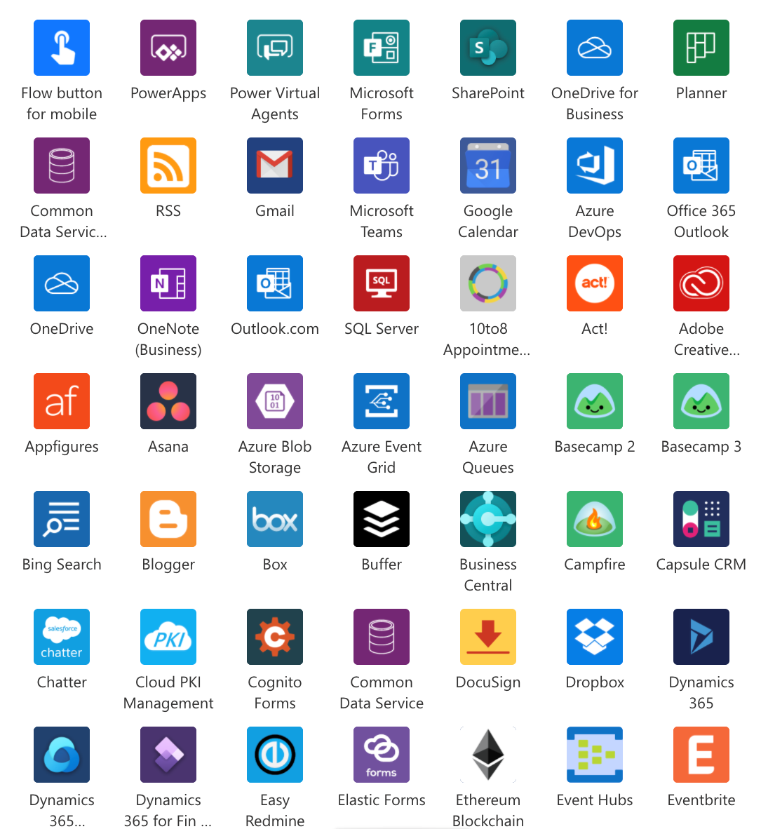



































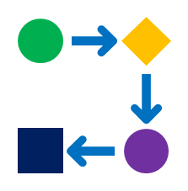













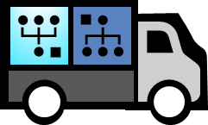








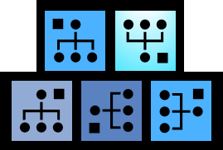
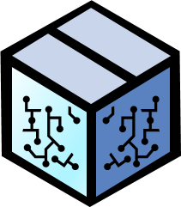
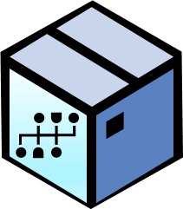




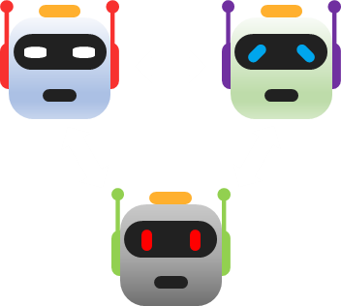


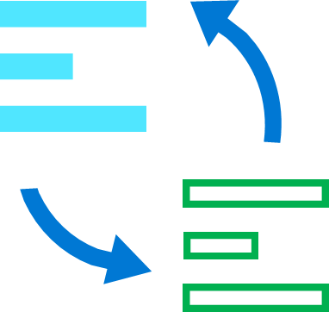






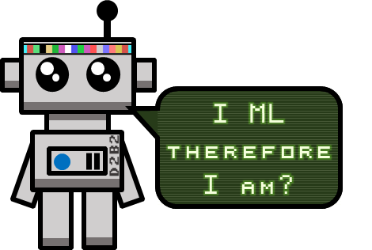


Microsoft AI Ecosystem
Use
Copilots
Extend Copilot reach using Plugins
Prompt Toolkit
Other AI enabled experience or process
Unofficial conceptual view of AI services and resources used to incorporate AI technology into organizations to achieve more with less.
Bing Integration
GitHub Copilot
Health, Finance, Retail and Industrial AI
Copilot experiences for Apps and Services
github.com/Pokeystuff/MSAIEcosystem
Copilot Development Stack
Connect AI to your data and build new AI and AI enabled experiences.
Your Data
Power Platform Connectors
(1000+)
Low-code
Power Platform
Copilot Studio
AI Builder
Other Apps and Services
Clouds
Custom Data
Data Lakes, Storage, Databases
On-premises
Build Copilots, AI enabled Apps and Business Automation without deep technical skills
Azure Cloud Services
RAG Pattern
Build and use Plug-ins
Retrieval Augmented Generation (RAG) grounds LLM responses by supplementing the LMM internal data with external data.
Microsoft Services
Connectors are the highways that allow information to travel to and from all the services in your technology ecosystem.
200+ Services
Build, run, and manage applications across multiple clouds, on-premises, and at the edge, with the tools and frameworks of your choice.
Copilot for Azure
Orchestration
SharePoint, Outlook
Teams, Power BI, OneDrive, Viva, Sales, Marketing, Finance and More…
Prompt + Knowledge → Response
App Service
Query → Knowledge
Azure AI Studio
Azure AI Services
Azure Machine Learning
Gen AI LM
Azure AI Search
Unified interface for Azure AI and ML solution management
Leverage AI in your organization without the need for data science skills using pre-created AI models
Build, fine-tune, and train custom AI and ML models grounded on your own data
Files, Databases, Lakes, Docs, Images
Dataverse
Fabric
OneLake
Create deep customised solutions with more technical control and operational management
Data Sources
Build
GPT LLMs
Whisper
Azure OpenAI Service
DALL-E
Assistants
Auto ML
MLOps
Prompt Flow
Notebooks
Azure Arc Hybrid and Multi-Cloud
On-Premises Data Gateway
Risk & Compliance
Unified Data Governance
Full dev control over the app and model behavior, higher fidelity data and feature integration
Grounding and Tuning
Provisioned Throughput
Data Privacy
Azure Integration Services
Data Science Virtual Machines
Microsoft
Purview
Compute Management
Responsible AI
Insights & Dashboard
Pipelines
Identify data risks, prevent data loss and manage regulatory requirements.
manage and govern on-premises, multi-cloud, and software as a service (SaaS) data
AI-powered information retrieval. Combine LLMs with heterogenous data for diverse application experiences.
ML Flow
Azure Marketplace
Azure Advisor
Explore
Compare
Evaluate
Improve
Safety
Azure AI Search
ML and AI Models
Data Sets and Models
Microsoft Research Open Data
Azure Open Datasets
Planetary Computer
Industry Data Models
Vision
Content Safety
Access and develop and train classic AI and Machine Learning models. Small, Medium and Large models. Generative AI, Language, Vision, Audio and Industrial models.
Integrate
Test
Review
Deploy
Monitor
Frameworks, Toolkits and SDK
Speech
Document Intelligence
Model as a Service
ONNX Runtime
Semantic Kernel
AutoGen
Bot Service
Immersive Reader
State
Memories
Side Effects
Plugins
Bot Framework
Data Science Toolkit
Responsible AI Toolbox
HAX Toolkit
Microsoft AI Value Accelerator (MAIVA)
Language and Translation
Video Indexer
Model Catalog
Custom / BYO
Vendor Pty
Opensource
AI UX
Copilot
Models
OpenAI & Azure AI Models
Open-source collection of proven ML and AI accelerators, enabling automation of commonly repeated development processes.
Learn about AI
Azure Spatial
Azure AI Containers on-premises
Easily build agents that can call your existing code. As a highly extensible, lightweight SDK, you can use Semantic Kernel with models from OpenAI, Azure OpenAI, Hugging Face, and more.
Develop LLM applications using multiple agents, LLMs and humans, that converse with each other to solve tasks.
A collection of libraries, tools, and services that let you build, test, deploy, and manage omnichannel bots.
Tools providing model and data exploration and assessment user interfaces and libraries that enable a better understanding of AI systems
For teams building user-facing AI products to conceptualize what the AI system will do and its behaviours. Use early in design process.
Responsible AI
Microsoft AI Blog
Global Infrastructure
Datacenter
GPU & AI Silicon
CPU
IO
Network
Circular Centers
Sustainability
Created by Dean Corcoran
End to end systems optimization
V1.51. Not an official Microsoft resource. All trademarks are property of their respective owners

Slide 4

Zoom in Azure AI Portfolio One place to build and deploy AI solutions
Azure AI Studio
Azure AI Services
Azure AI Search
Azure Machine Learning
Unified user interface (UI)
SDK
CLI
Vision
Speech
Language / Translation
Document Intelligence
Azure OpenAI
Content Safety
Retrieval Augmented Generation (RAG)
Semantic
Vector
Ground
Evaluate
Deploy
Monitor
MLOps / LLMOps
Responsible AI Dashboard
Turing
Florence
GPT-4 and GPT 3.5 Turbo
Whisper
DALL-E
Embeddings
Meta Llama 2
Hugging Face
Model as a Service
Azure Infrastructure
Model as a Platform

Slide 5
Azure OpenAI compliance
To date Azure OpenAI Service has been certified or assesses against 40 of the 103 compliance offerings that Microsoft measures global compliance against (Global, Regional & Industry)
23 NYCRR 500
Argentina PDPA
CSA Star Attest
CSA Star Cert
CSA Star Self-Assessment
ISO 20000-1:2011
ISO 22301:2012
ISO 27001:2013
ISO 27017:2015
Canada Privacy Law
CDSA
FIPS 140-2
FedRAMP High
ISO 27018:2019
ISO 27701:2019
ISO 9001:2015
HiTRUST
MARS-E (US)
DESC
UK G-Cloud
DoD DISA SRG L2
SOC 1, 2, 3
SOX
European BA Export (EAR)
HIPAA BAA
Germany C5
GDPR
GxP (FDA21 CFR11)
HDS (France)
UK Cyber Essentials+
NERC
OSPAR
SEC Regulation
NIA
PCI 3DS
PCI DSS Level 1
NIST CSF
TruSight
WCAG 2.0
Singapore MTC
TISAX
The Azure OpenAI Service certifications are described in the Microsoft Azure Compliance Offerings document

Slide 6


Fuel your journey to AI innovation by getting your data AI ready
Build generative AI experiences on top of your data
3
Prepare data for AI innovation
Establish a central repository for all data
2
Enhance the breadth and depth of data-driven experiences by creating an AI solution
1
Improve the quality of your data, to ensure it is complete, accurate, and governed
Integrate disparate data sources into a unified data platform and data lake
Microsoft Fabric data experiences
OneLake
Azure AI Studio

Slide 7
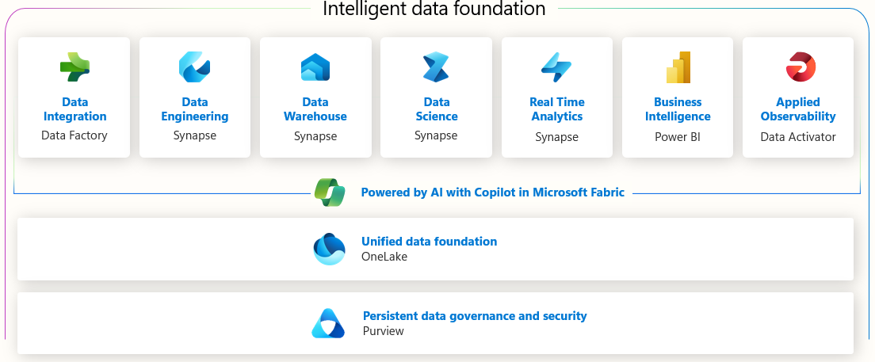

Microsoft Fabric
Bring your teams together on a complete data platform
Unify all data into one single estate for analytics
Empower your business users
Supercharge productivity with AI
Give your data teams all the tools they need in a unified experience that reduces the cost and effort of integration and simplifies governance.
Simplify data integration from nearly any source, and work from the same copy of data across analytics engines and languages.
Quickly go from data sitting in a lakehouse to stunning visuals in Microsoft 365 apps, empowering more people with insights.
Adopt a data platform that’s infused with AI at every layer to help you get more done, faster.

Slide 8
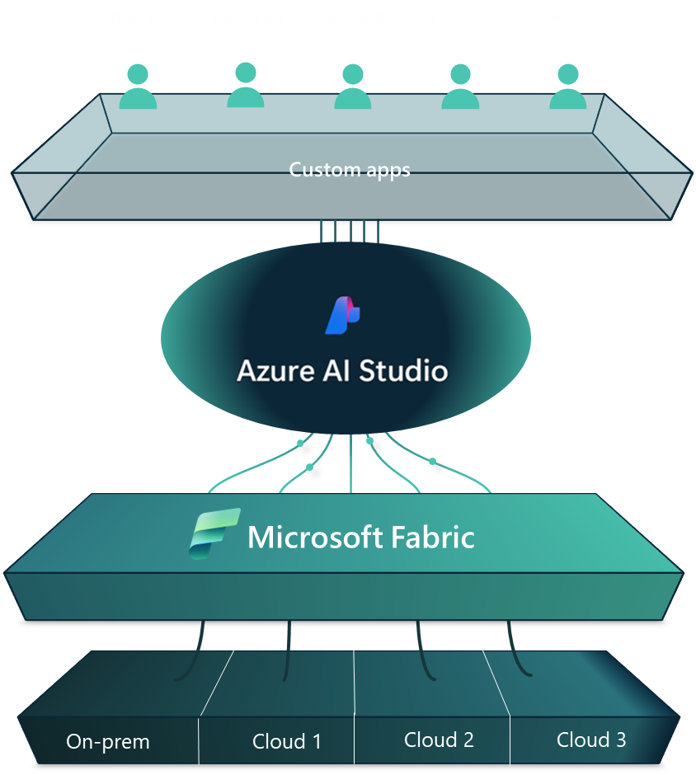

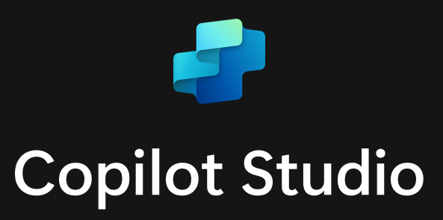

Azure AI+Fabric vs. Extender Copilot for M365
Consistent Experience
Teams
Power Point
Apps…
Copilot for
Microsoft 365
Microsoft Graph

Slide 9
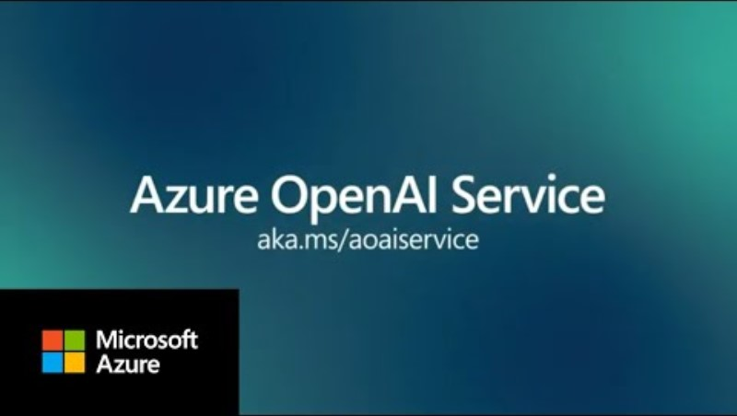
On Your Data is now GA in Azure OpenAI Service
Using your data with Azure OpenAI Service - Azure OpenAI | Microsoft Learn

Slide 10
Azure AI has three differentiated speech to text offerings All of them with generally available models
Azure AI Speech
Azure OpenAI Service
Real-time Speech to Text
Batch Speech to Text
Azure openai Whisper
Streaming
Up to 24 hours of SLA
Near real-time
SDK and CLI
Supports custom models
Rest API and CLI
Supports custom models
Rest API
Microsoft Speech to Text(STT)
Microsoft
STT
OpenAI Whisper
OpenAI Whisper
All generally available models
Microsoft Confidential

Slide 11
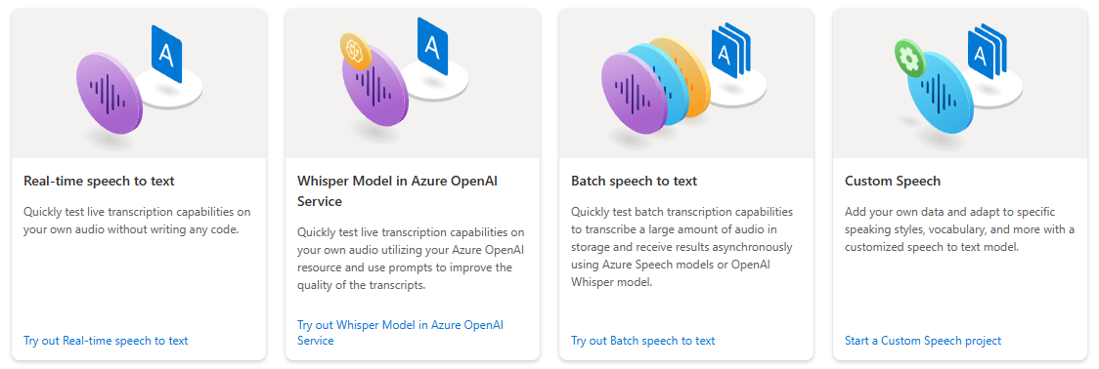
In Azure AI Speech Studio, Try out and Evaluate the Whisper Model and the Azure AI Speech models
You can try-out and evaluate Azure AI Speech and Whisper models in Azure AI Speech Studio

Slide 12
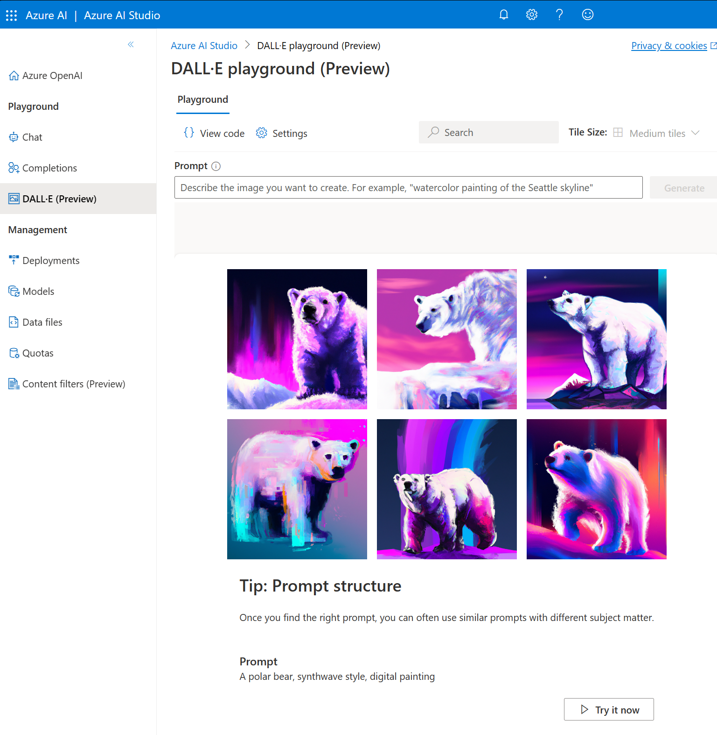
AOAI’s DALL-E for image generation
Quickstart: Generate images with Azure OpenAI Service - Azure OpenAI | Microsoft Learn

Slide 13
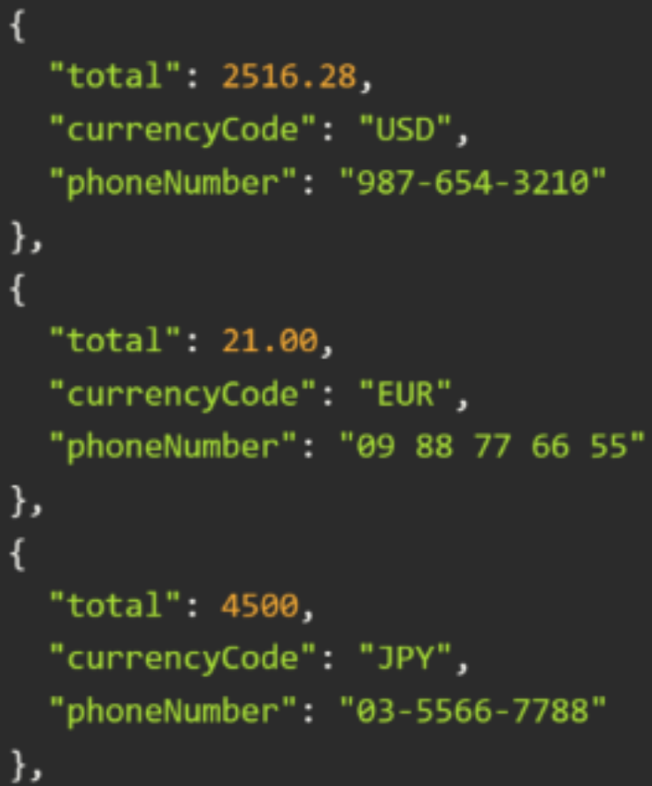
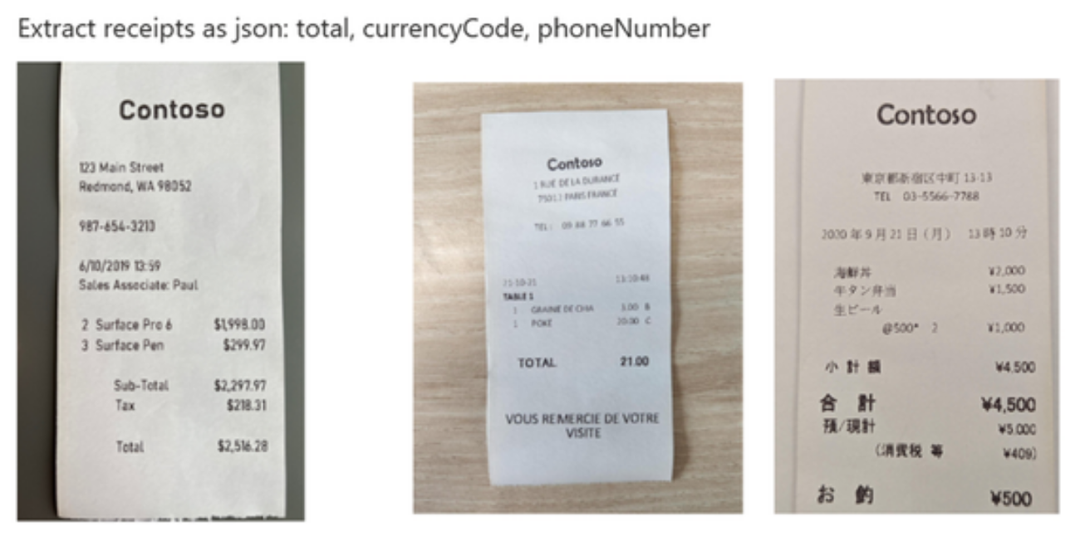
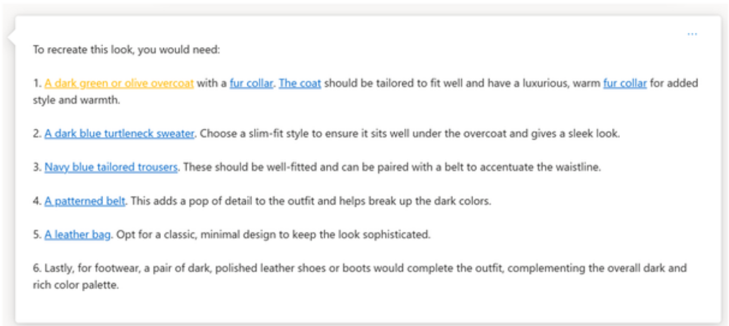

GPT-4V: GPT4 with Vision
GPT-4V
…is a large multimodal model
…answers general questions about what is present in the images or videos you upload
…e.g. write a caption or a story based on it, or even generate code or design prototypes from combined textual and visual inputs
GPT-4 Turbo with Vision concepts - Azure OpenAI | Microsoft Learn

Slide 14
AOAI – Ownership of the IP rights of Output Content
Output Content of AOAI (including images and text):
The AOAI Service is governed by its service terms. Under these terms today, Microsoft does not claim ownership of the output of the service. Except for our acceptable use policies, Microsoft’s terms do not restrict the commercialization of content generated by the service, although customers are ultimately responsible for making their own decisions about the commercial usability of content they generate.
Who is responsible for third-party claims regarding the use of AOAI services under applicable law:
The Product Terms for AOAI Service state “Microsoft will defend customers against third party intellectual property claims related to AOAI Output Content, provided, Customer Copyright Commitment conditions are satisfied (for AOAI and other services with configurable metaprompts) which requires customers to implement the required mitigations at the website: Customer Copyright Commitment Required Mitigations | Microsoft Learn”
IP Ownership of Output Content
Broader Products Scope (i.e. including other Microsoft first-party products generated using AOAI services and limited to image content) :
The AOAI Service, Designer app, and Image Creator are all governed by their respective service terms. Under these terms today, Microsoft does not claim ownership of the output of these services. Except for our acceptable use policies, Microsoft’s terms do not restrict the commercialization of images generated by these services, although customers are ultimately responsible for making their own decisions about the commercial usability of images they generate.
For Reference Only. Please Consult with Legal Advice.

Slide 15


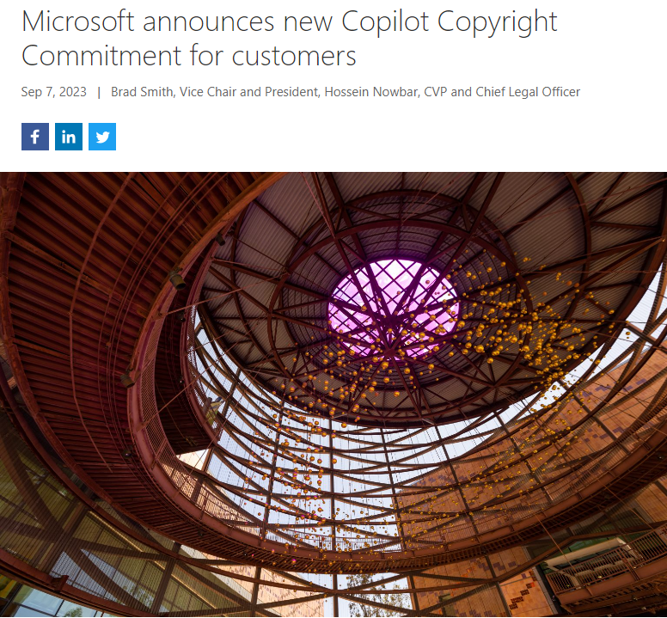
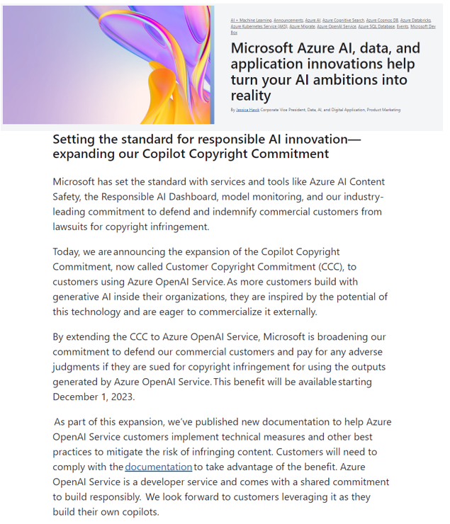
Customer Copyright Commitment (CCC)

Slide 16
Customer Copyright Commitment
Universal Required Mitigations:
Category | Required Mitigation | Effective Date
Metaprompt | The customer offering must include a metaprompt directing the model to prevent copyright infringement in its output, for example, the sample metaprompt, "To Avoid Copyright Infringements" at: System message framework and template recommendations for Large Language Models(LLMs) | December 1, 2023
Testing and Evaluation Report | The customer offering must have been subjected to evaluations (e.g., guided red teaming, systematic measurement, or other equivalent approach) by the customer using tests designed to detect the output of third-party content. Significant ongoing reproduction of third-party content determined through evaluation must be addressed. The report of results and mitigations must be retained by the customer and provided to Microsoft in the event of a claim. More information on guided red teaming is at: Red teaming large language models (LLMs). More information on systematic measurement is at: Overview of Responsible AI practices for Azure OpenAI models - Azure AI services - Microsoft Learn. | December 1, 2023
Azure OpenAI Service Only - Additional Required Mitigations Per Use Case
Content type | Use Case | Category | Required Mitigation | Effective Date
Code generation | Code generation or transformation scenarios, or other open code generation scenarios | Content filters | The protected material code model must be configured on in either annotate or filter mode. If choosing to use annotate mode, customer must comply with any cited license provided for Output Content that is the subject of the claim. The jailbreak model must be configured on in filter mode. | December 1, 2023
Text generation | Journalistic content, writing assistance, or other open text generation scenarios | Content filters | The protected material text model must be configured on in filter mode. The jailbreak model must be configured on in filter mode. | December 1, 2023
*Use cases are related to what the customer has requested in the Limited Access Form
Customer Copyright Commitment Required Mitigations | Microsoft Learn

Slide 17
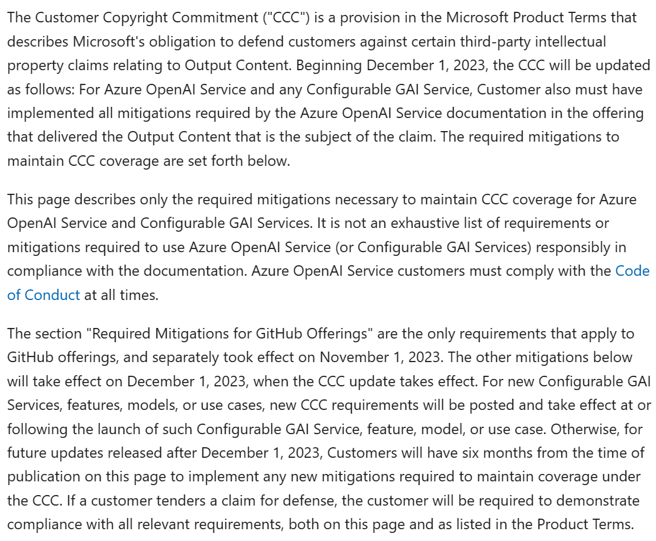
Customer Copyright Commitment
Customer Copyright Commitment Required Mitigations | Microsoft Learn

Slide 18
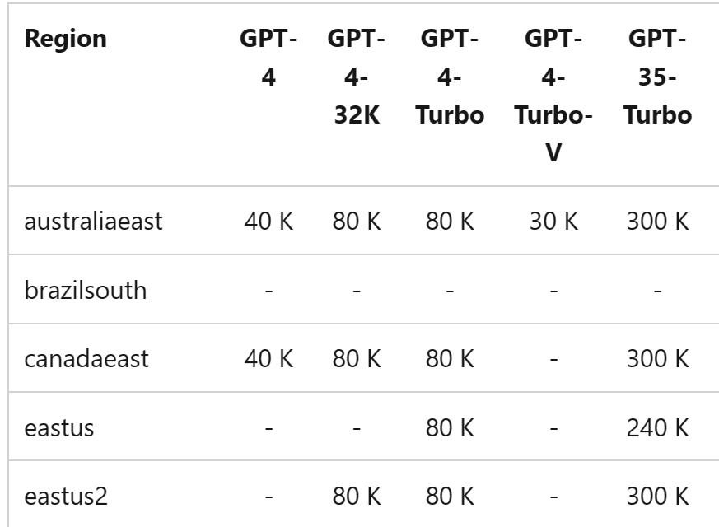
AOAI Quota and Key concept
Quota is assigned to your subscription on a per-region, per-model basis in units of Tokens-per-Minute (TPM). Your subscription is onboarded with a default quota for most models.
For example, with a 240k TPM quota for GPT-35-Turbo in East US, you could create
one deployment of 240K TPM
two of 120K TPM each,
or multiple deployments adding up to less than 240K TPM
in that region.
Refer to this document for default TPM values.

Slide 19
How about TPM rate limits?
TPM rate limits are based on the maximum tokens **estimated** to be processed when the request is received. It is different than the token count used for billing, which is computed after all processing is completed. Azure OpenAI calculates a max processed-token count per request using:
- Prompt text and count - The max_tokens setting - The best_of setting
This estimated count is added to a running token count of all requests, which resets every minute. A 429 response code is returned once the TPM rate limit is reached within the minute.
A **Requests-Per-Minute** (RPM) rate limit is also enforced. It is set proportionally to the TPM assignment at a ratio of 6 RPM per 1000 TPM.

Slide 20

Implement retry logic in your application.
Avoid sharp changes in the workload. Increase the workload gradually.
Test different load increase patterns.
Increase the quota assigned to your deployment. Move quota from another deployment, if necessary.
Raise request to increase quotas via link
Consider creating more AOAI resources in another region, then implement the load balancing mechanism
Consider deploying PTU, especially for Production workload that requires low latency
Optimizing Azure OpenAI: A Guide to Limits, Quotas, and Best Practices - Microsoft Community Hub

Slide 21


Azure OpenAI | Procurement Options
Pay as you go (PayGo):
Performance is best effort TPMs based upon regional availability
Cost is variable, lower for small workloads, higher for larger workloads and spikes.
No SLA on TPM for PayGo.
Provisioned Throughput Units (PTU):
Performance is guaranteed/predictable
Cost is fixed/predictable, monthly commitments.
SLAs provided for Committed PTUs.
Shared Capacity/Best Effort
Dedicated Capacity/ Guaranteed
Customer B
Customer A
Customer A
Customer B
You
EastUS Region
You
Challenges with PayGo: Assuming an average conversation is ~5k TPM and only 20k TPM capacity is available shared region that is limited/capped, this limits you to only 4 concurrent chat sessions. Users can expect high latency or quota/capacity errors.

Slide 22
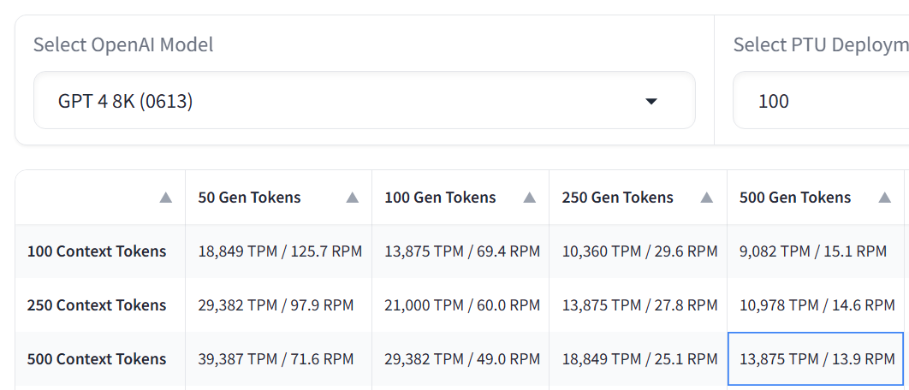
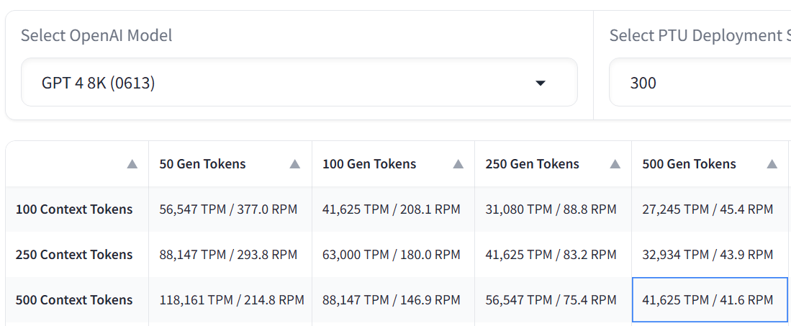
Scalability with PTUs
PTU
…
PTU
Subscription 1
Subscription 2
Subscription N
PayGo 120K* TPM
PayGo 120K* TPM
…
PayGo 120K* TPM
PTU
…
PTU
Subscription 1
Subscription 2
Subscription 'n'
Load Balancing
Subscription 1
PayGo TPM limited to fixed TPM per subscription
PTUs can be utilized on their own or increased to add processing capacity
*TPM limits are for GPT-3.5 Turbo. Limits vary by model. See the latest information here.

Slide 23
Customer experience with latency and throughput
"
"
Client #1
Client #2
Client #3
We switched from PayGo to GPT4 Turbo 1106 PTU. It is very fast – 2-3 sec vs. 10-20s for PayGo [on the same workload].
Results were quite positive. Tested Azure PTU vs PayGo. Azure PTU was much better, best performance, most stable [and] less latency.
Switched from Azure PayGo to PTU for the same workload and saw latency go from 12-13 secs down to 2-3 seconds in the same region.
"
"
Analytics and insights company
Americas
Chatbot services company
Americas
Large visual entertainment company
Americas

Slide 24
Choosing the best Consumption Model
PayGo |  | PTU
Variable cost, usage based |  | Consistent cost
Capped throughput |  | Scalable throughput
No assigned latency |  | Assigned latency
Good for: Sandbox / test environment Lower volume workloads Intermittent usage scenarios Use cases resilient to throughput variability or slowness when service is busy |  | Recommended for: Production workloads High volume workloads Throughput heavy workloads Latency sensitive scenarios

Slide 25
Deploy foundation models with a built-in safety system
Your application
System Message & Grounding
Azure AI Content Safety
Azure OpenAI Model
Modified Prompt
Modified & Filtered Prompt
User Prompt
App Response
Filtered Response
Response
Model • Safety System • System Message & Grounding • User Experience

Slide 26
Our GenAI Products are responsible by design
AI User
Prompt
AI Application
Filtered Response
Completion
Synchronous Content Filtering
Abuse Concern?
Asynchronous Abuse Monitoring
AI Content Safety
PII
Self-Harm
Violence
Jailbreak
Copyright
Sexual
Hate
AI Model

Slide 27
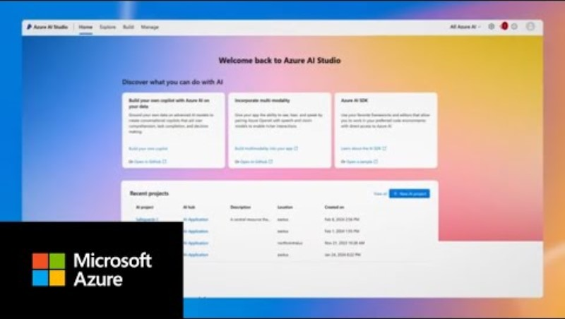

Slide 28





Evaluate generative AI application quality with Azure AI Studio
Azure AI Studio automated evaluations
AI-assisted dataset generator
or
Customer’s test dataset
test prompts
Your application endpoint
app responses
Groundedness, Relevance, Fluency, Coherence, Similarity
AI-assisted quality evaluator
evaluation results

Slide 29
Azure Responsible AI
Content Harms Filters |  |  | 
Prompt Shield for Indirect Attacks |  |  | 
Ungrounded material detection |  |  | 
Safety system message |  |  | 
Safety evaluations |  |  | 
Risks and safety monitoring | 
Azure OpenAI Service
Azure AI Content Safety
Azure AI
Studio


Slide 30
Well-Architected Framework for AOAI
Principle | Example
Reliability | Monitor rate limits for pay-as-you-go: If you're using the pay-as-you-go approach, manage rate limits for your model deployments and monitor usage of tokens per minute (TPM) and requests per minute (RPM).
Security | Microsoft Entra ID: Use Microsoft Entra ID for authentication and to authorize access to Azure OpenAI by using role-based access control (RBAC).
Cost Optimization | Design client code to set limits: Your custom clients should use the limit features of the Azure OpenAI completions API, such as maximum limit on the number of tokens per model (max_tokens) or number of completions to generation (n). Setting limits ensures that the server doesn't produce more than the client needs.
Operational Excellence | Enable Azure Diagnostics: Configure Diagnostics for the Azure OpenAI Service to collect and analyze metrics and logs
Performance Efficiency | Use provisioned throughput for production workloads: PTU offers dedicated memory and compute, reserved capacity, and consistent maximum latency for the specified model version.
Azure Well-Architected Framework perspective on Azure OpenAI Service - Microsoft Azure Well-Architected Framework | Microsoft Learn

Slide 31
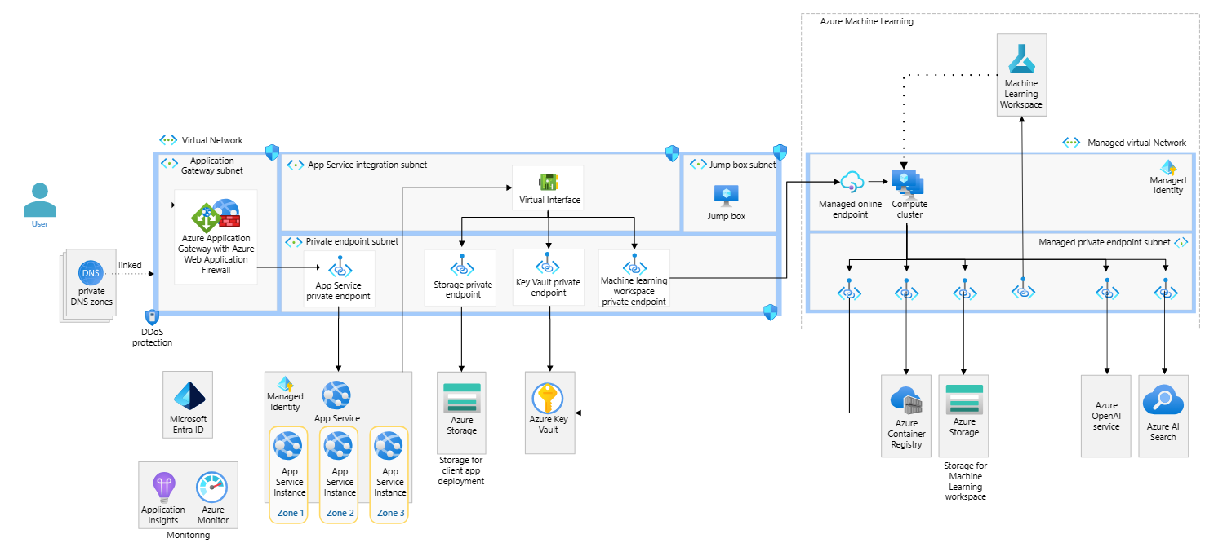
Baseline AOAI end to end chat
Baseline OpenAI end-to-end chat reference architecture - Azure Reference Architectures | Microsoft Learn

Slide 32
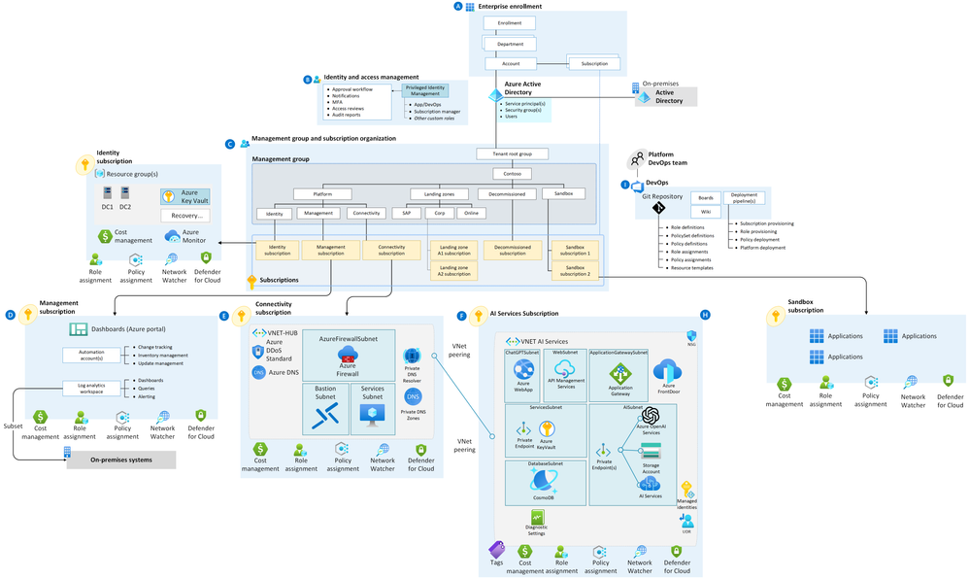
AOAI Landing Zone
Azure OpenAI Landing Zone reference architecture (microsoft.com)

Slide 33
AOAI Architecture Pattern
AOAI with Azure Frontdoor for loadbalancing
AOAI with APIM
Round Robin load balancing with Retry logic
AAD authentication from APIM to Azure OpenAI
Policy to extract callerID (Subject from APIM)
Logging and Monitoring using APIM
AOAI with Frontdoor and APIM multi-region deployment for a full-fledged multi-region availability
Azure OpenAI Architecture Patterns and implementation steps - Microsoft Community Hub

Slide 34
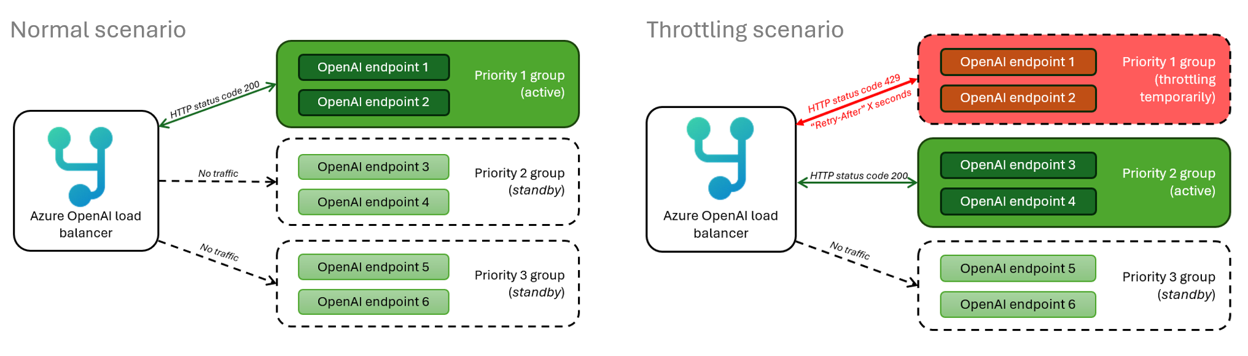
Smart load balancing for AOAI endpoints and APIM
GitHub - Azure-Samples/openai-apim-lb: Smart load balancing for OpenAI endpoints and Azure API Management
GitHub - Azure-Samples/openai-aca-lb: Smart load balancing for Azure OpenAI endpoints
Intelligent Load Balancing with APIM for OpenAI: Weight-Based Routing - Microsoft Community Hub

Slide 35
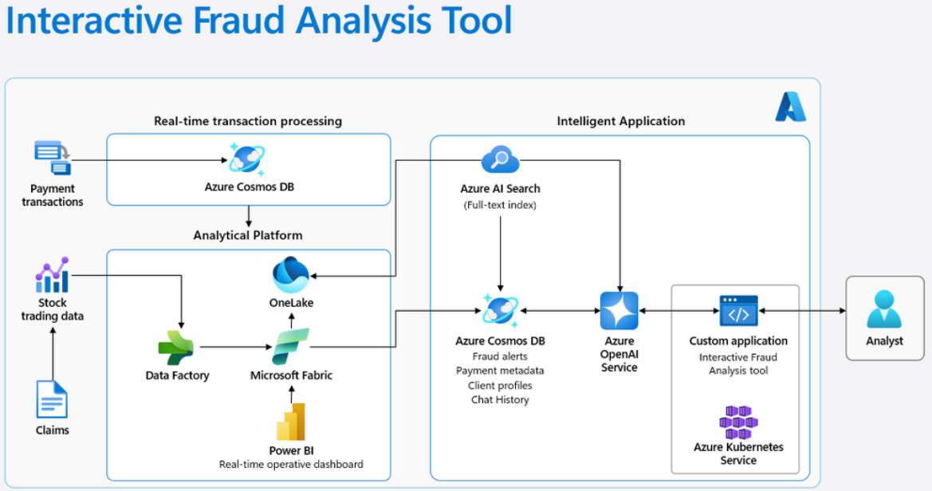
Be inspired! 5 real world examples
AI in action: 5 real-world intelligent apps you can build on Azure (microsoft.com)

Slide 36


Apps
Plugin extensibility
Copilots
What is an orchestration SDK?
AI Orchestration
Foundation models
AI infrastructure

Slide 37
GenAI Popular Framework
To Build GenAI Agents:
Langchain: most popular opensource framework (Python/Javascript)
Tutorial:Superpower LLMs with Conversational Agents | Pinecone
LLamaIndex: this framework focuses more on data management for LLMs, like RAG, memory, etc. It's becoming very popular and even some products are being built on top of it. Can be coupled with Langchain. (Python)
Documentation: LlamaIndex 🦙 0.8.63.post2
Semantic Kernel: built and maintained by Microsoft (Python/C#/Java). It provides quite a lot of freedom when building your custom code.
Tutorial:In-depth Semantic Kernel tutorials | Microsoft Learn
General Framework/Tools
Promptflow: LLMOps tool from Microsoft. focuses on quick experimentation and iterations with different prompts.
Tutorial: Tutorials — Prompt flow documentation (microsoft.github.io)
Vscode extension for local development: Prompt flow for VS Code - Visual Studio Marketplace
Autogen: Built by Microsoft. Let's you build agents that communicates with each other.

Slide 38
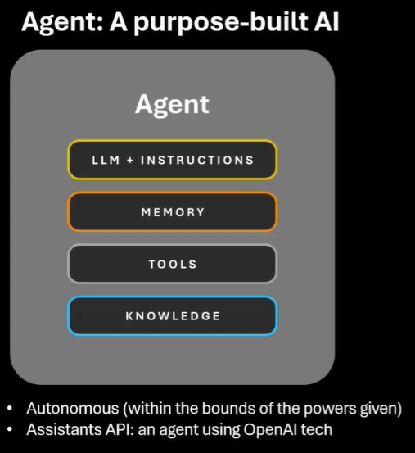

Slide 39
Langchain
Langchain is an open-source framework for building applications based on large language models (LLMs).
Benefits of Langchain
Repurposing LLMs: Langchain allows organizations to repurpose LLMs for domain-specific applications without retraining.
Simplified AI Development: It abstracts complexities of data source integrations and prompt refining.
Context-Aware Workflows: Langchain enables context-aware workflows, reducing model hallucination and improving response accuracy.

Slide 40
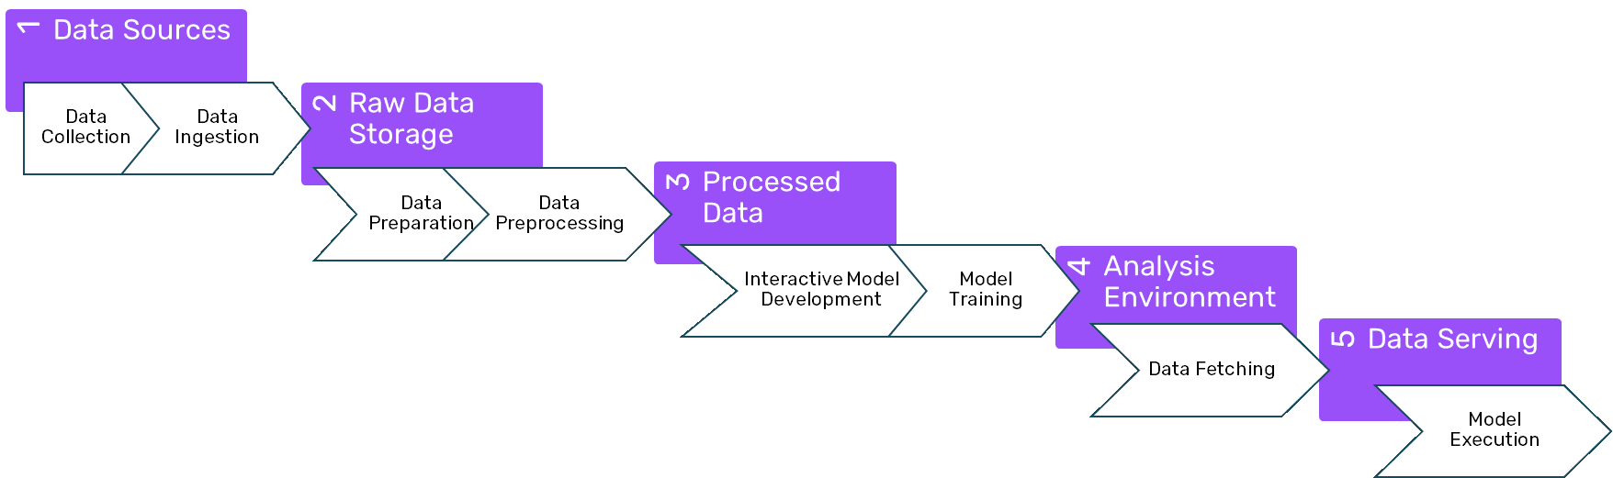
LangChain was built by and for AI researchers who have experience building AI data pipelines.

Slide 41
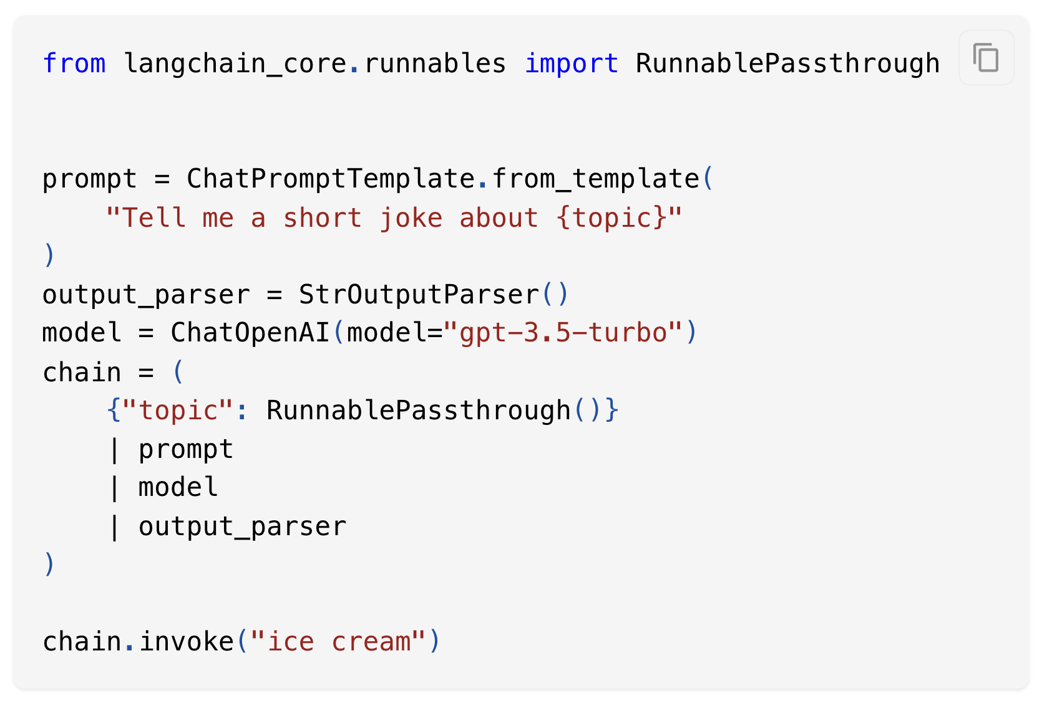
LangChain
At the core of LangChain are chains
In Chains the sequence of actions are hardcoded, cannot change the sequence of actions depending on the task at hand.
With chains, you pipe together elements (e.g., prompts, models, and parsers) before invoking it

Slide 42
Langchain, agents
The core idea behind agents is to: utilize a language model to make decisions about a sequence of actions.
Unlike chains, where actions are hardcoded directly in code, agents leverage a language model as a reasoning engine
Agent Types, : There are various types of agents available, each suited for different scenarios
Tools, Agents are only as effective as the tools they have at their disposal

Slide 43
Langchain agent concepts
Schema: Abstractions that simplify working with agents.
AgentAction: Represents the action an agent should take, including the tool to invoke and its input.
AgentFinish: The final result from an agent, containing the agent’s output.
Intermediate Steps: Previous agent actions and corresponding outputs from the current run.
Agent, This is the chain responsible for deciding what step to take next. This is usually powered by a language model, a prompt, and an output parser.
Agent input
Agent outputs, The output is the next action(s) to take or the final response to send to the use, AgentAction or AgentFinish
AgentExecutor: The runtime that calls the agent, executes actions, and repeats the process.
next_action = agent.get_action(...) while next_action != AgentFinish: observation = run(next_action) next_action = agent.get_action(
..., next_action,
observation) return next_action

Slide 44
Langchain
import langchain from langchain.llms
import OpenAI from langchain.agents
import ZeroShotAgent from langchain.memory
import TextMemory from langchain.prompts
import PromptTemplate
# Initialize the LLM (e.g., GPT-3.5 Turbo)
llm = OpenAI(model="gpt-3.5-turbo-0613")
# Create a simple agent
agent = ZeroShotAgent(llm=llm)
# Define a conversation prompt
conversation = [
"User: What's the weather like today?",
"Agent: I'll check for you.", ]
# Execute the agent
response = agent.execute(conversation)
# Print the agent's response
print("Agent's Response:") print(response)
Simple zero shot agent
With prior conversation

Slide 45
Langchain, adding tools
Adding tool/function
Providing tool to Langchain
Start agent
from langchain import hub
from langchain.agents import AgentExecutor, create_openai_functions_agent
from langchain_openai import ChatOpenAI
# Get a prompt from the hub (you can modify this)
prompt = hub.pull("hwchase17/openai-functions-agent")
# Initialize the LLM (e.g., GPT-3.5 Turbo)
llm = ChatOpenAI(model="gpt-3.5-turbo", temperature=0)
# Create the agent with the defined tools and prompt
agent = create_openai_functions_agent(llm, tools, prompt)
# Execute the agent (you can customize the input)
response = agent.execute({"input": "get me three data points"})
# Print the agent's response print("Agent's Response:")
print(response)
from langchain_core.tools import tool
@tool def get_data(n: int) -> list[dict]:
"""Get n data points."""
return [{"name": "foo", "value": "bar"}] * n
# List of tools (you can add more tools if needed)
tools = [get_data]

Slide 46
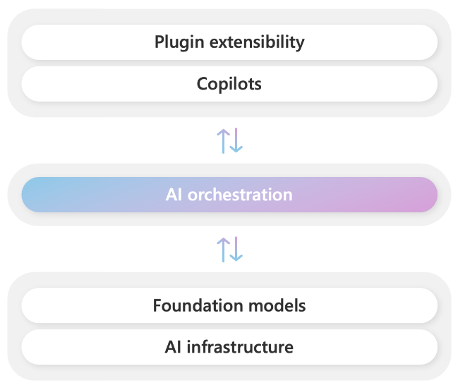
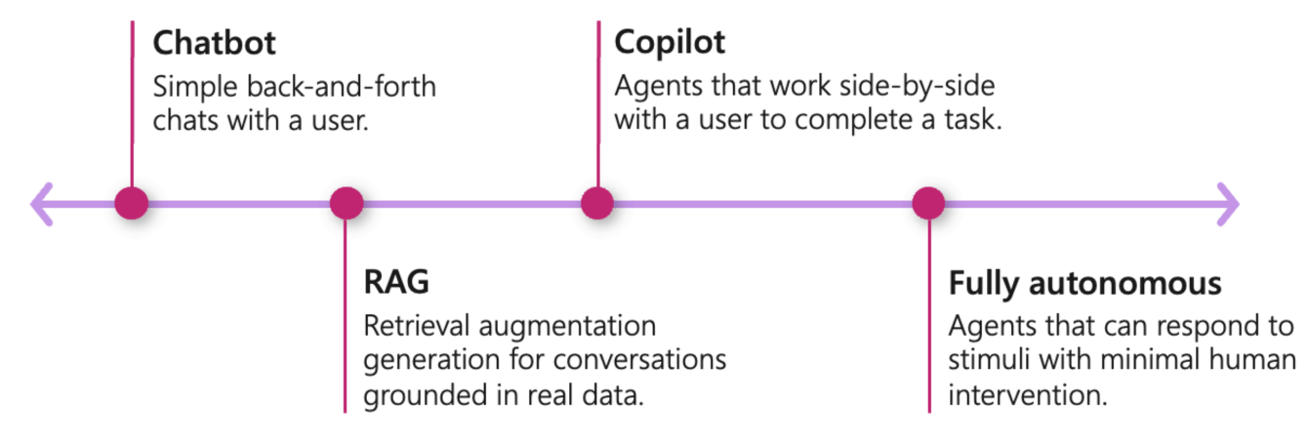
Semantic kernel
Is an open-source SDK that empowers developers to build AI agents by seamlessly integrating Large Language Models (LLMs) with conventional programming languages like C#, Python, and Java
Serves as the central orchestration layer in an AI agent stack
Combine AI models and plugins (your existing code) to create new user experiences

Slide 47
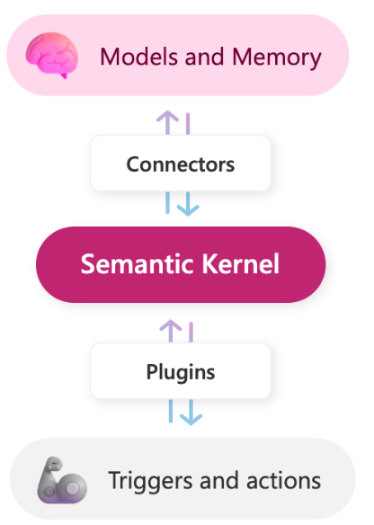
Semantic kernel
Semantic Kernel acts as the central orchestrator within an agent stack.
Imagine an agent tasked with managing a smart home. It needs to control lights, thermostats, and security systems.
Define plugin/plugins
Access memory
Conventional key-value pairs: Just like you would set an environment variable in your shell, the same can be done when using Semantic Kernel. The lookup is "conventional" because it's a one-to-one match between a key and your query.
Conventional local-storage: When you save information to a file, it can be retrieved with its filename. When you have a lot of information to store in a key-value pair, you're best off keeping it on disk.
Semantic memory search: You can also represent text information as a long vector of numbers, known as "embeddings." This lets you execute a "semantic" search that compares meaning-to-meaning with your query.

Slide 48
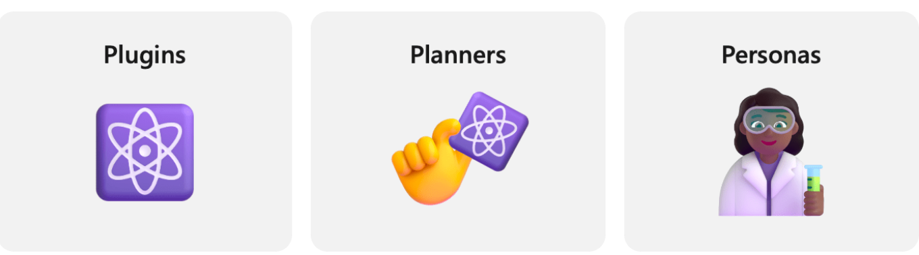
Semantic Kernel
Plugins, giving your agent skills
Planners, give guidance to your agent. Planners are special prompts that allow an agent generate a plan to complete a task
Personas, set the chat history, but also give it “behavior”

Slide 49




With plugins, AI can automate tasks
Semantic Kernel
ChatGPT
M365 Copilot
Bing
Your application
Chatbots are nice, but they aren’t useful to your users until they can interact with the real world by…
Retrieve data
Sending emails
Completing sales
Making orders
And more!
1
2
AI Plugins
3
4
5

Slide 50
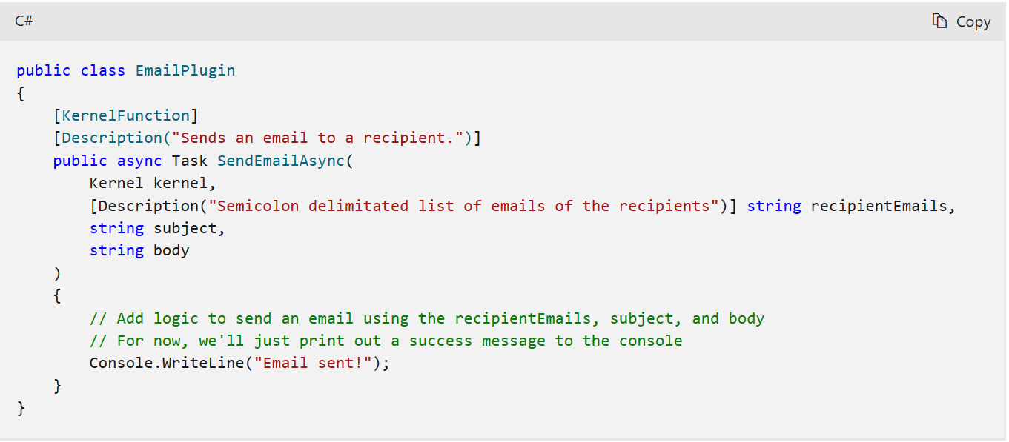
SK Plugins
The actual skill you give it

Slide 51
At the core of every copilot is a planner
Orchestrating plugins
The plan
Planners tell a Copilot what it should do next with the tools it has. Semantic Kernel has 5 generations of planners
Action planner
Sequential planner
Stepwise planner
1
The planner
2
3
Automatic function calling
Handlebars planner
Stepwise v2 planner
*
4
5

Slide 52
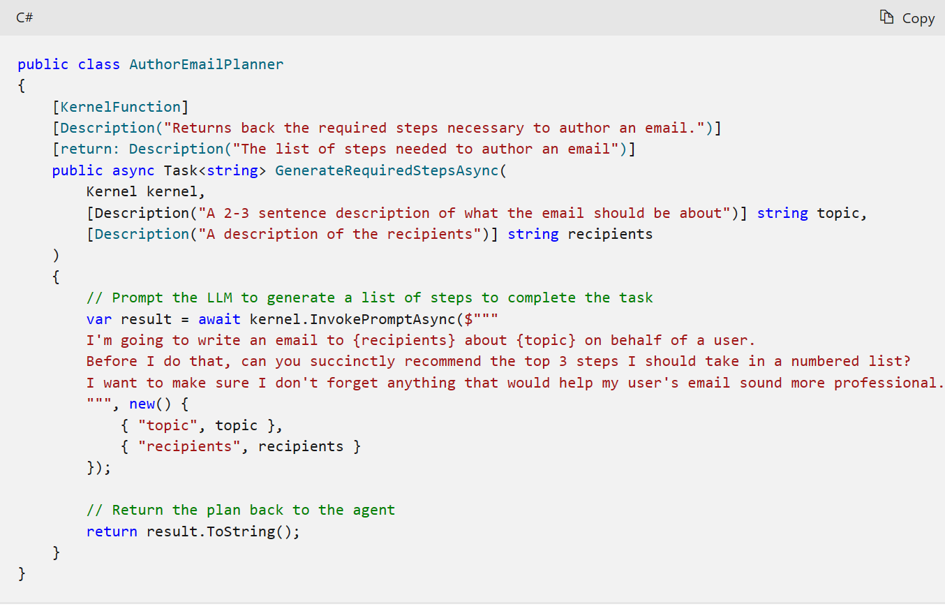
Semantic Kernel Planner
How to do something. Template + data

Slide 53
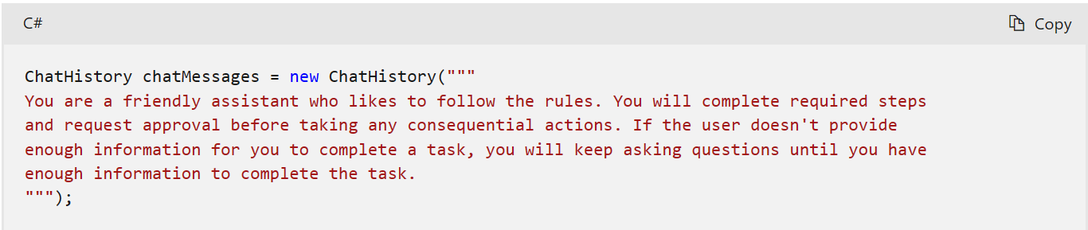
Semantic Kernel Personas
Give your agent a personality

Slide 54
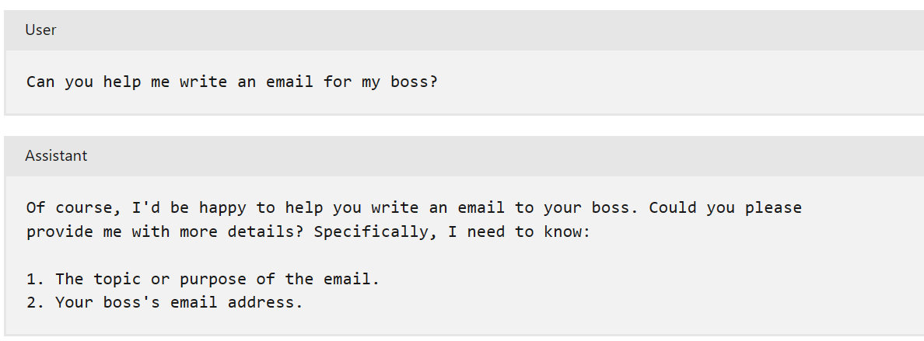
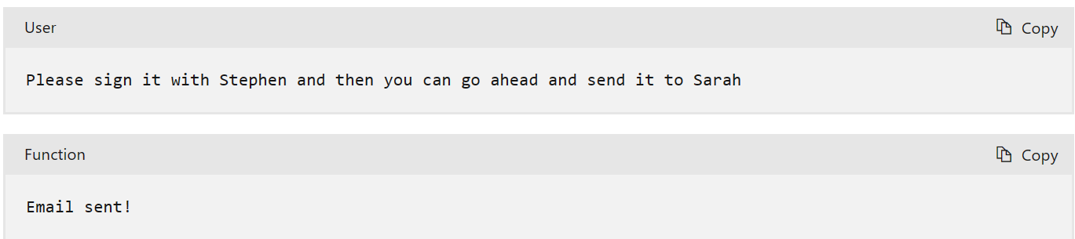
All together
Chat conversation
Activates the planner (creating a draft)
Asking for planner parameters
for the draft
Activates the plugin (sending email)

Slide 55
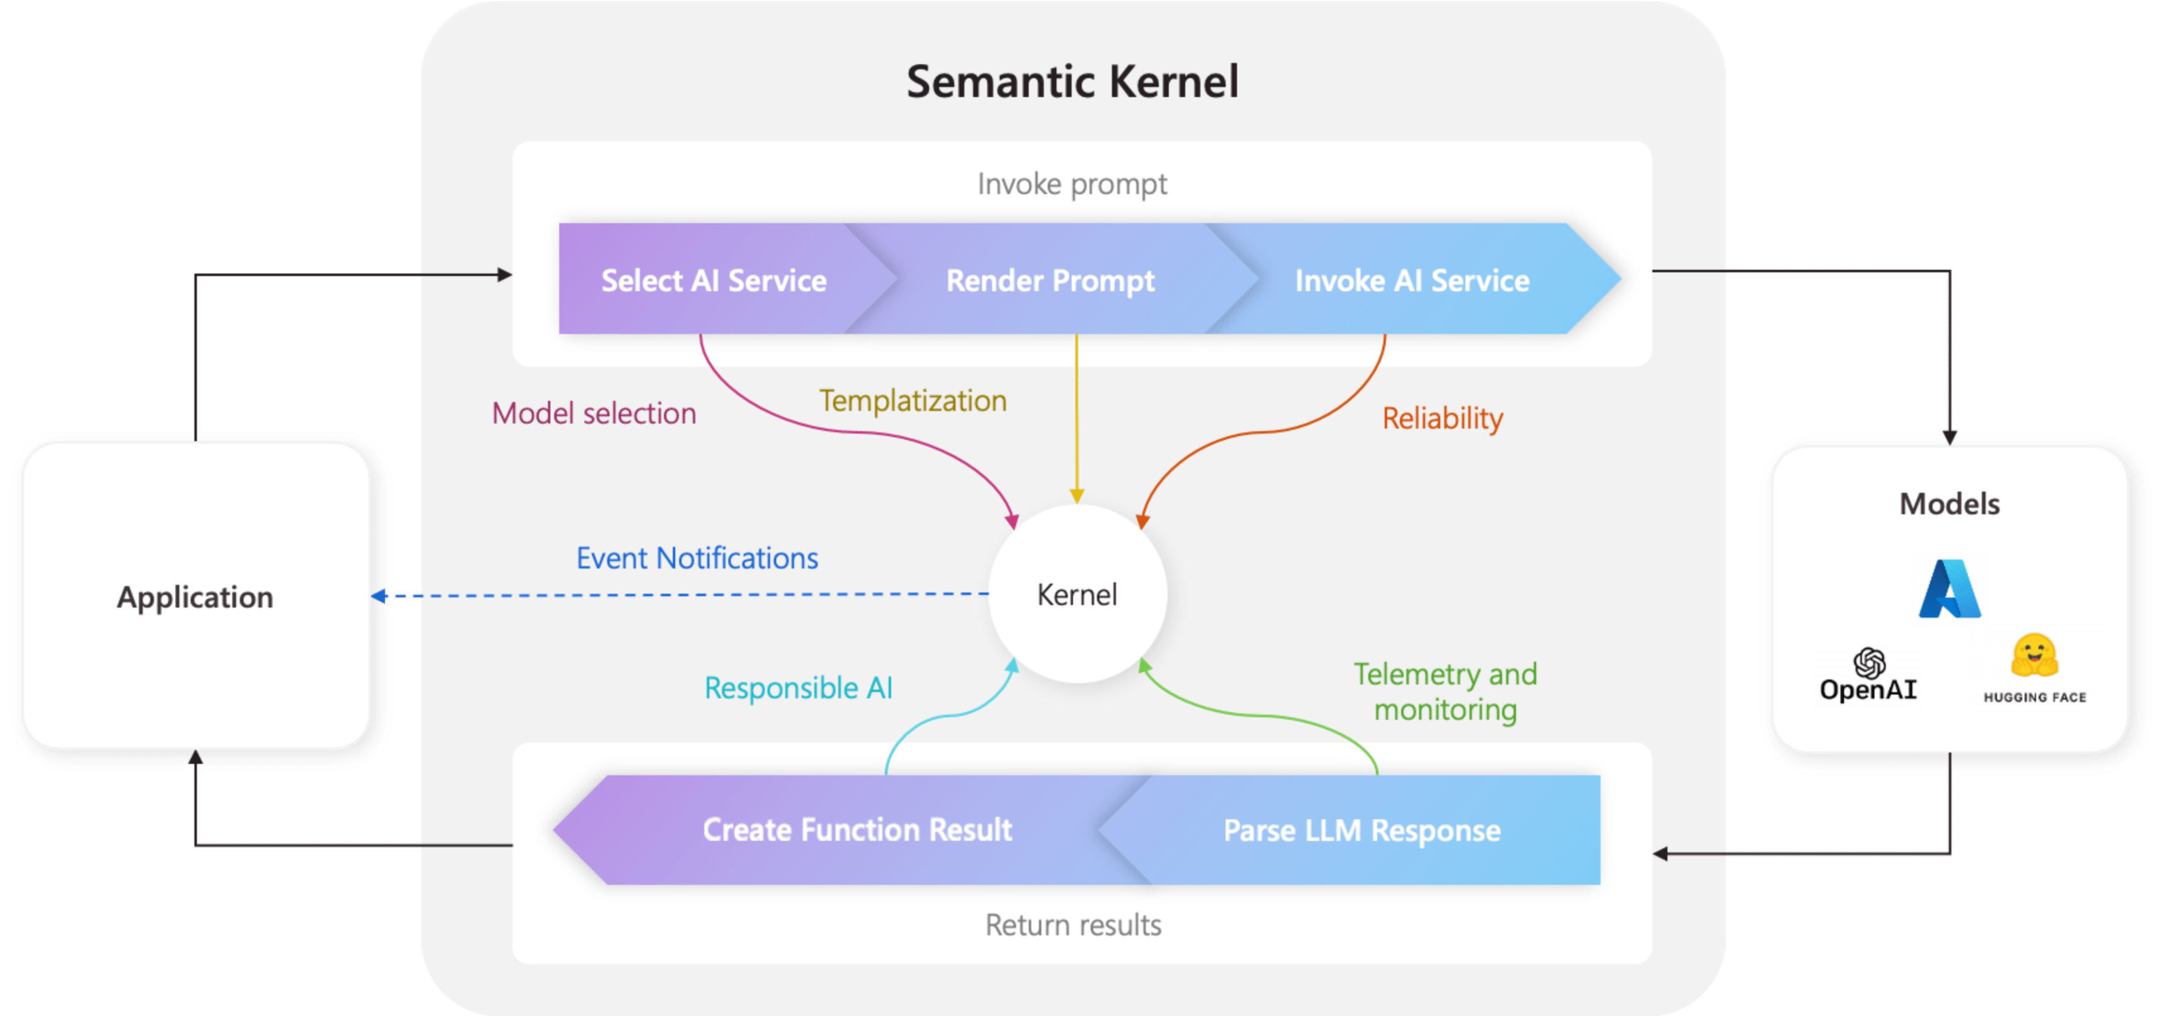
Supported And Semantic Kernel gives devs complete control with the kernel languages
Semantic Kernel

Slide 56
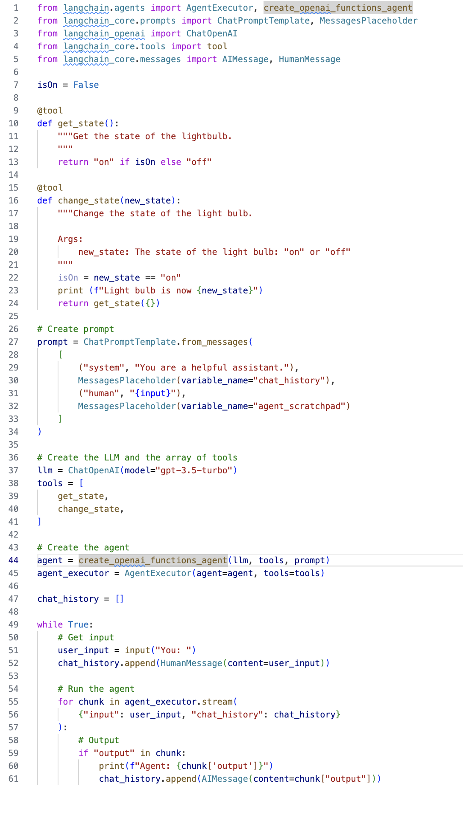
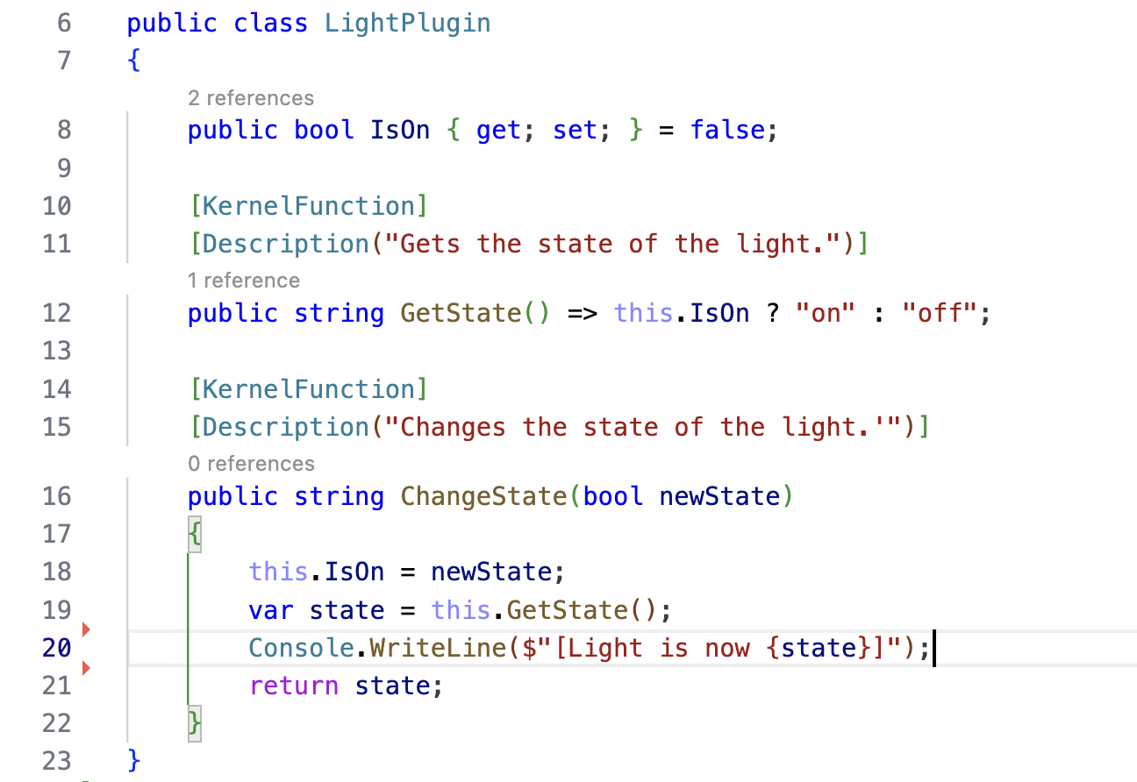
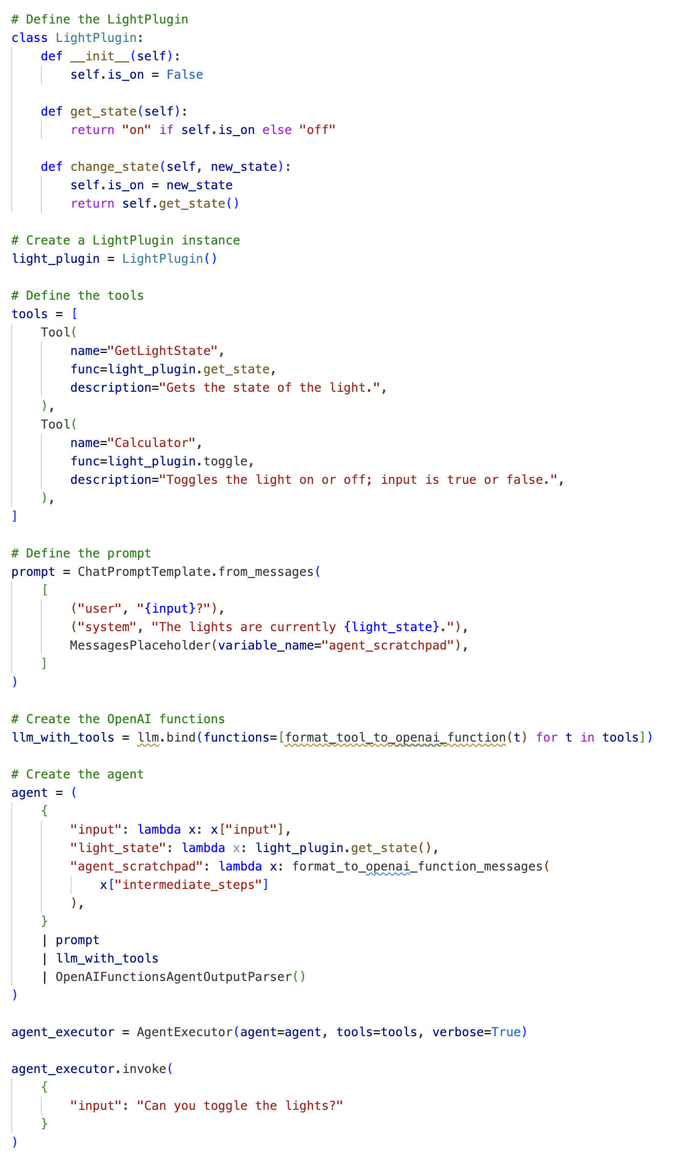
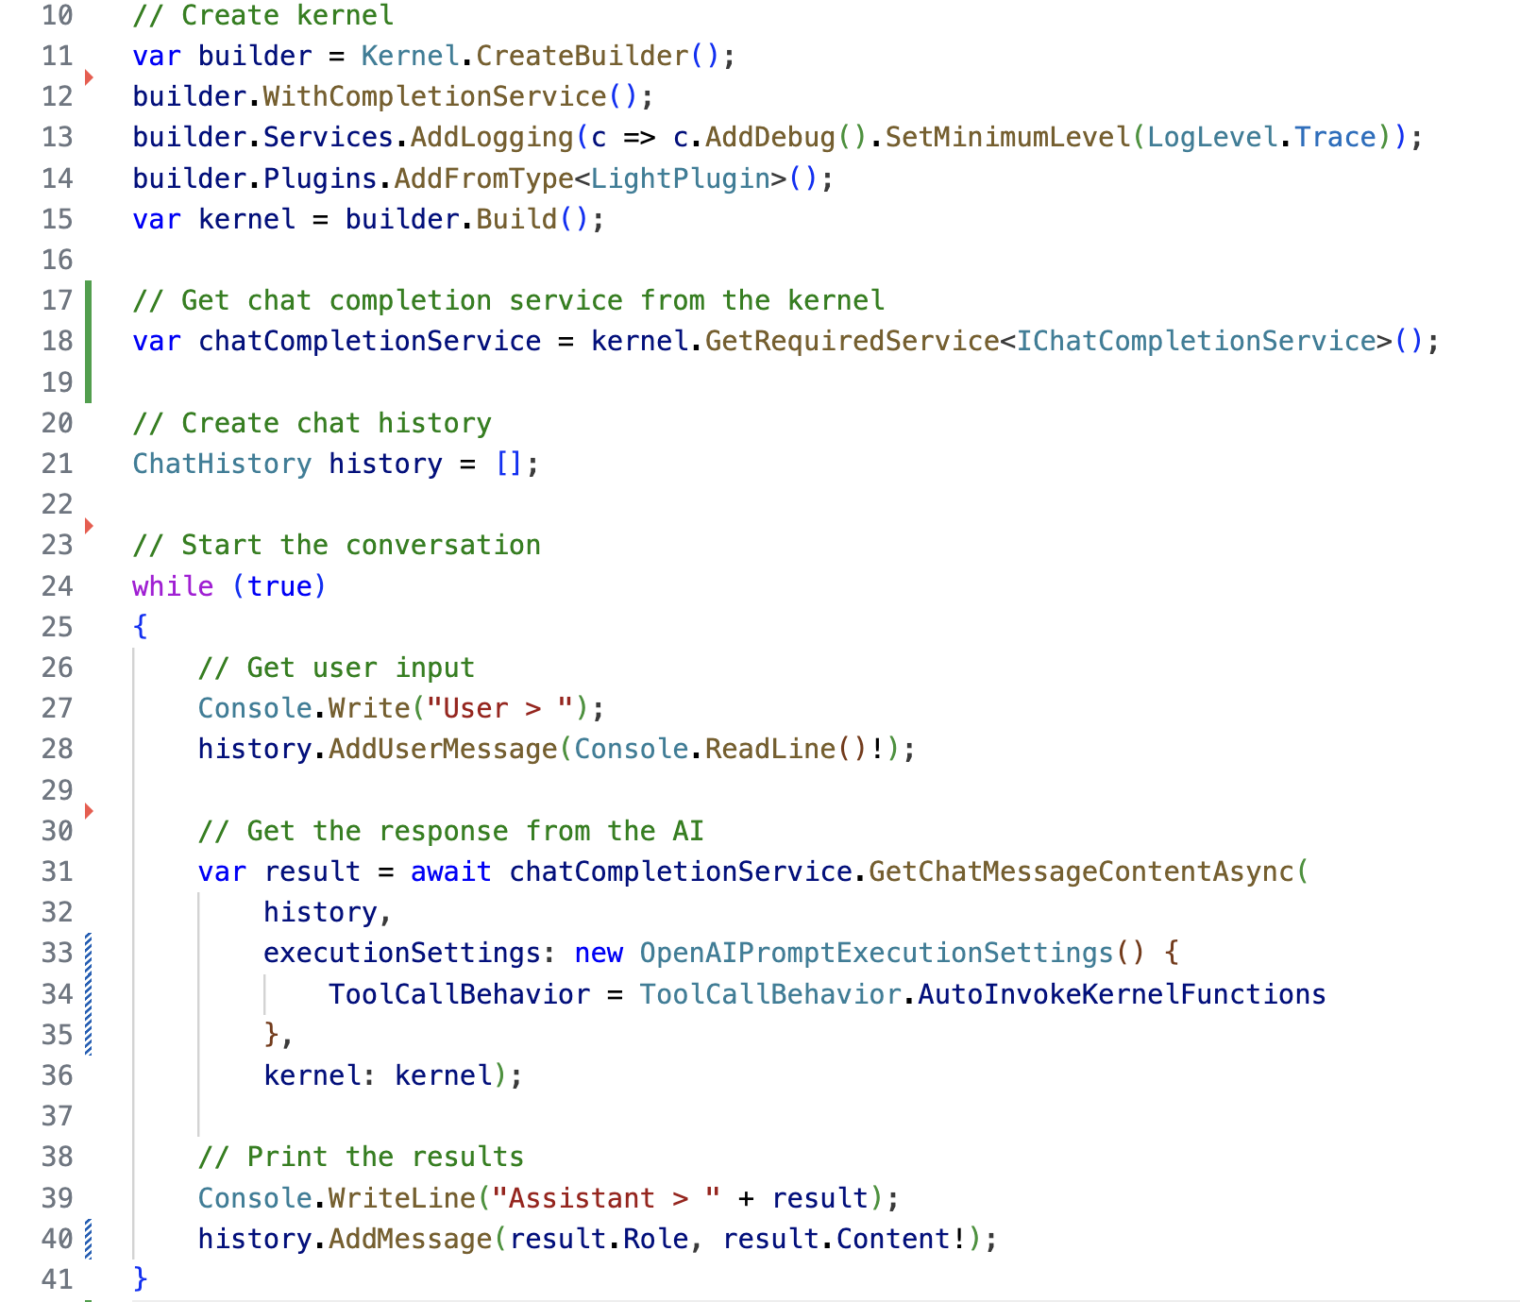
LangChain
Using LCEL
Semantic Kernel
V1.0.0

Slide 57
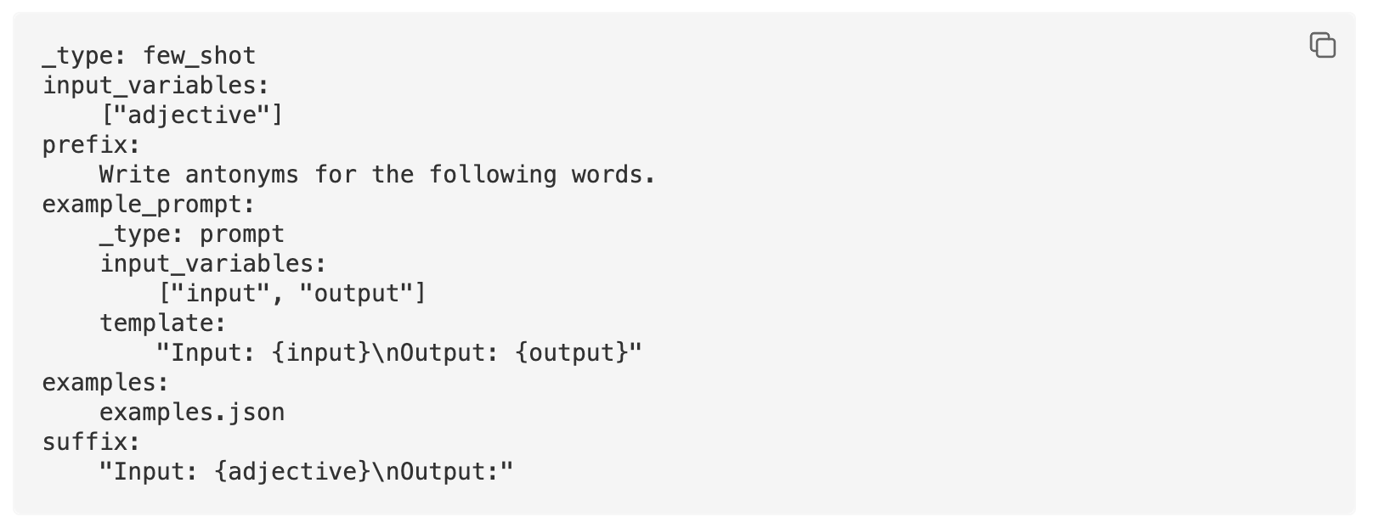
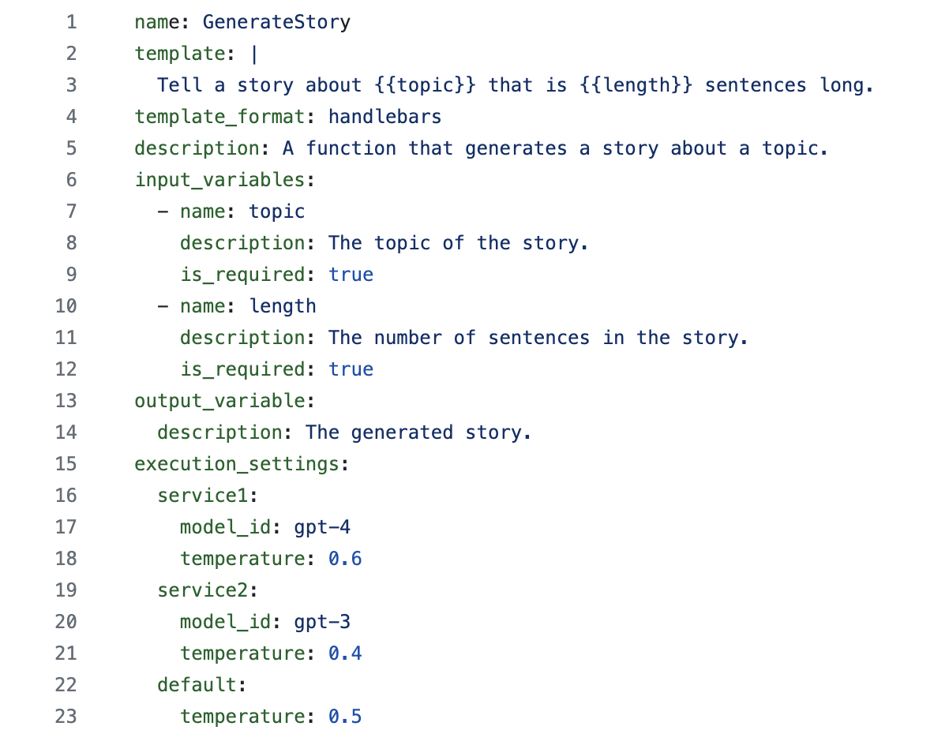
Semantic Kernel follows the prompt specification used by Azure AI Studio to include execution settings.
Prompts
LangChain
Semantic Kernel
1
LangChain only serializes the prompt, you then need to use chains to combine prompts with models and settings.
2
Semantic Kernel allows you to define settings for multiple services so that you can easily swap models for a given prompt.

Slide 58
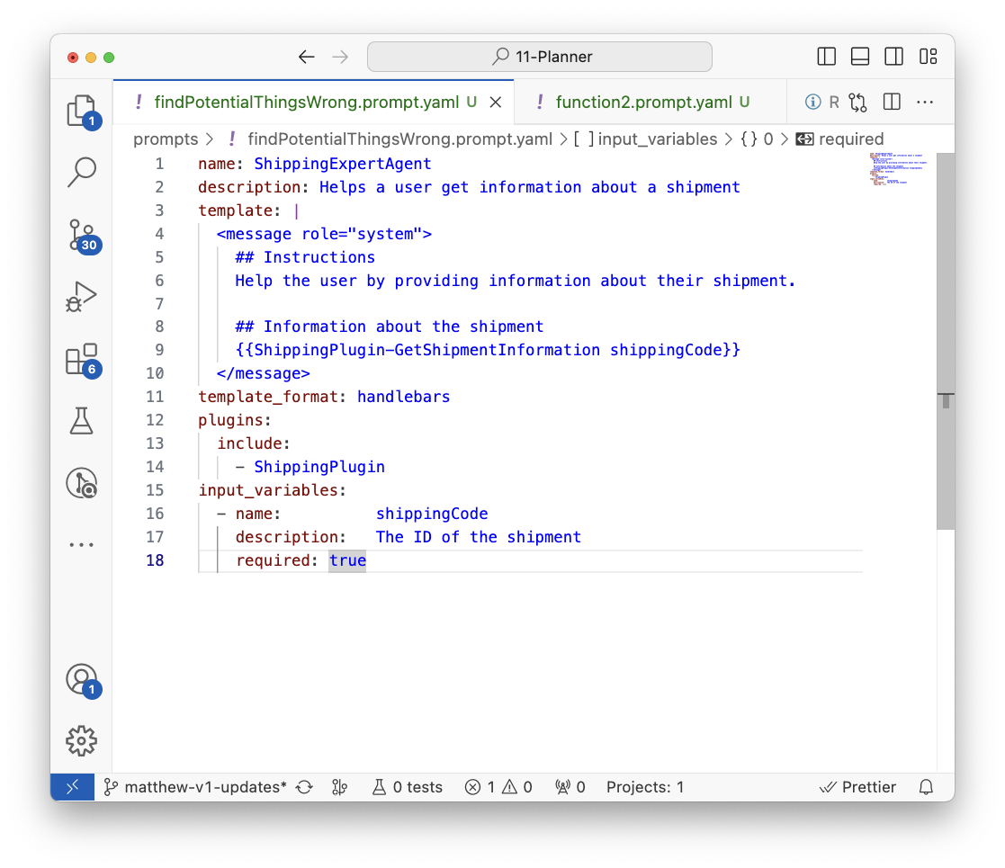



All Semantic Kernel SDKs will support YAML and Handlebars for cross-language support of prompts
Prompts
AI teams
App dev teams
LangChain predominantly uses Jinja2 which is not supported outside of Python

Slide 59
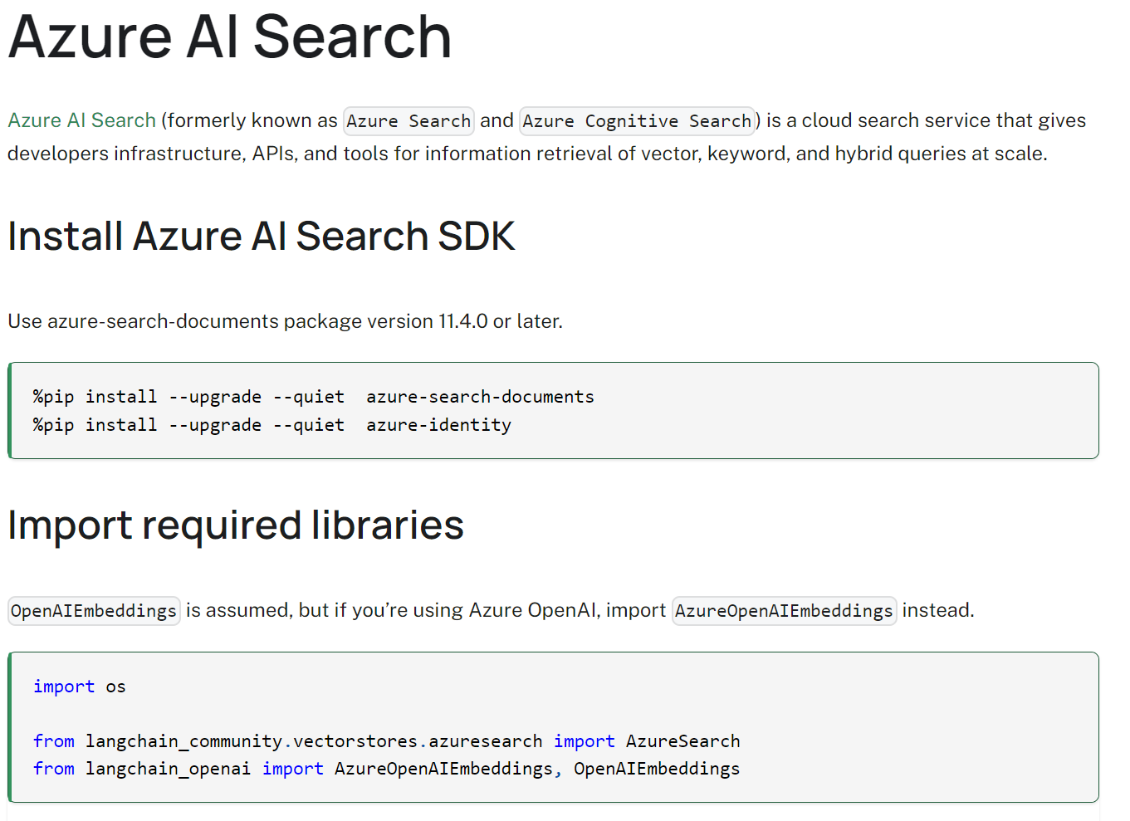
In LangChain, most multi-modal capabilities are one-off tools without a common abstraction
Standardized abstractions
For example, this makes it difficult to swap the component with another model.

Slide 60

Semantic Kernel has interfaces for the common model types to afford swapping in the future
Standardized abstractions
Because our text to audio services all implement the same interface, you can replace it in the future.

Slide 61





Additionally, all models use the same content types
Standardized abstractions
Text Content
Message Content
Image Content
Audio Content
Video Content
This makes it possible to use the outputs of one model as the input of another model

Slide 62



Benefits
What’s next?
These differences will make it easier to support multi-modal in the future.
1
First-class plugin support allows devs to bring their apps and services to AI.
Kernels will make it easier to bundle multiple modalities together.
Prompts for specific modalities can be bound to specific models.
Common content types across models will make it easier for inputs / outputs to be reused.
Chat
2
Audio
3
Video
Doc updates
4
Responses need to feel instant

Slide 63

LLamaIndex
Is a powerful data framework designed for LLM (Large Language Models)-based applications that benefit from context augmentation
Provides essential tools to:
Ingest, structure, and access private or domain-specific data.
Safely and reliably inject this data into LLMs for more accurate text generation.
Is particularly useful for Retrieval-Augmented Generation (RAG) systems

Slide 64
LlamaIndex, agents
from llama_index.agent.openai import OpenAIAgent
from llama_index.llms.openai import OpenAI
# Initialize LLM (e.g., GPT-3.5 Turbo)
llm = OpenAI(model="gpt-3.5-turbo-0613")
# Initialize OpenAI agent with relevant tools
agent = OpenAIAgent.from_tools(
tools,
llm=llm,
verbose=True)
Data Agents are intelligent knowledge workers within LlamaIndex.
They can perform various tasks over your data, both in a “read” and “write” function.
Capabilities of Data Agents:
Automated Search and Retrieval: They can retrieve information from different types of data (unstructured, semi-structured, and structured).
API Interaction: Data Agents can call external service APIs in a structured fashion, process the responses, and store relevant information for later use
Core Components, A data agent requires the following core components:
Reasoning Loop: Given an input task, the data agent uses a reasoning loop to decide which tools to use, in which sequence, and with what parameters.
Tool Abstractions: Data Agents interact with APIs or tools. These abstractions define how the agent interacts with external services.
Reasoning loops vary based on the type of agent:
OpenAI Function agent (built on the OpenAI Function API).
ReAct agent (works across any chat/text completion endpoint).
LLMCompiler Agent (available as a LlamaPack)
Building a Custom Agent - LlamaIndex

Slide 65


Slide 66

Autogen
Is a framework that enables the development of LLM (Large Language Model) applications using multiple agents
These agents can converse with each other to solve tasks
Key features
Customizable: Developers can tailor them to specific needs.
Conversable: They engage in dialogue.
Human Participation: They seamlessly allow human input.

Slide 67

Why Autogen
Solving Tasks: It facilitates task-solving through multi-agent conversations.
Next-Gen LLM Applications: AutoGen simplifies building next-gen LLM applications.
Complex Workflow Orchestration: It streamlines the orchestration, automation, and optimization of complex LLM workflows.
Performance Maximization: AutoGen enhances LLM model performance and overcomes weaknesses.
Diverse Conversation Patterns: Developers can create various conversation patterns, considering autonomy, agent count, and topology.

Slide 68

How does it work?
AutoGen provides a generic multi-agent conversation framework.
Agents collaborate by sending/receiving messages as part of a conversation that terminates when the task is completed.
These agents can
autonomously perform tasks OR
incorporate human feedback.

Slide 69
Your first conversable agent
Setup
Call agent
import os from autogen import ConversableAgent agent = ConversableAgent( "chatbot", llm_config={"config_list": [{"model": "gpt-4", "api_key":
os.environ.get("OPENAI_API_KEY")}]}, code_execution_config=False, # Turn off code execution, by default it is off. function_map=None, # No registered functions, by default it is None. human_input_mode="NEVER", # Never ask for human input. )
reply = agent.generate_reply(messages=[{"content": "Tell me a joke.", "role": "user"}]) print(reply)

Slide 70

Autonomous Multi agents
Two agents, no humans involved
cathy = ConversableAgent( "cathy", system_message="Your name is Cathy and you are a part of a duo of comedians.", llm_config={"config_list": [{"model": "gpt-4", "temperature": 0.9, "api_key":
os.environ.get("OPENAI_API_KEY")}]}, human_input_mode="NEVER", # Never ask for human input. ) joe = ConversableAgent( "joe", system_message="Your name is Joe and you are a part of a duo of comedians.", llm_config={"config_list": [{"model": "gpt-4", "temperature": 0.7, "api_key":
os.environ.get("OPENAI_API_KEY")}]}, human_input_mode="NEVER", # Never ask for human input. )
result = joe.initiate_chat(cathy, message="Cathy, tell me a joke.", max_turns=2)

Slide 71
Control agent conversation with termination conditions
result = joe.initiate_chat( cathy, message="Cathy, tell me a joke.", max_turns=3 ) # increase the number of max turns before termination
Chat level
max_turns, how many turns back and forth between agents
Agent level
max_consecutive_auto_reply
is_termination_msg
joe = ConversableAgent( "joe", system_message="Your name is Joe and you are a part of a duo of comedians.", llm_config={"config_list": [{"model": "gpt-4", "temperature": 0.7, "api_key":
os.environ.get("OPENAI_API_KEY")}]}, human_input_mode="NEVER", # Never ask for human input. is_termination_msg=lambda msg: "good bye" in msg["content"].lower(), )

Slide 72

Code executor
Enable agents to not just chat but also to interact with an environment and perform useful computations and take actions
Is a component that takes input messages (e.g., those containing code blocks), performs execution, and outputs messages with the results.
Two types of built-in code executors,
one is command line code executor, which runs code in a command line environment such as a UNIX shell,
the other is Jupyter executor, which runs code in an interactive Jupyter kernel.
Can be executed in two ways, locally and in a Docker container

Slide 73


Slide 74
Which framework you go with is up to you, just remember, an agent should have the below features..
Architecture patterns, e.g resiliency, retry, to ensure the agent performs well
Search
SearchIndex, vector stores, comparison approaches
Tools, Functions
RAG

Slide 75


Plugins also make it easy to integrate with other AI SDKs
Semantic Kernel
Plugin
Llama Index
Semantic Kernel agent

Slide 76


Slide 77

Semantic Kernel enabling AI orchestration by combining AI models and plugins to create new experiences for users. It's particularly useful for automating business processes and making AI agents more productive by calling existing code
AutoGen helps managing complicated workflows that involve multiple agents, each with different skills and functions.
Microsoft Semantic Kernel and AutoGen: Open Source Frameworks for AI Solutions

Slide 78

Prompt flow with Semantic Kernel
Why use Prompt flow with Semantic Kernel? | Microsoft Learn

Slide 79
Prompt flow with Semantic Kernel

Slide 80
Summary
Tool | Description
Promptflow | Good for initial phases of experimentation, particularly for extensive test swipes. Useful for establishing a framework for prompt experimentation and evaluation.
Langchain | Langchain provides quick out-of-the-box tutorials the constant improvements pose a challenge in locating the most up-to-date documentation and code.
Semantic Kernel | Semantic kernel requires a bit more time to ramp up but provides more flexibility and customization. Good for prompt engineering Good for simple use-cases/demo
Autogen | Autogen is an excellent tool for testing a variety of elements difficult to manage, and may yield inconsistent responses, resulting in a high number of required API calls. Ideal for exploring the use of specialized agents to complete tasks. Beneficial for assessing how a group of agents tackle a particular problem (e.g., website creation, prediction model generation).

Slide 81




Microsoft Copilot Studio
Build your own copilot
Create and publish a custom copilot for your organization using the intuitive building experience enhanced with large language models and generative AI
Customize Microsoft Copilot Extend and customize 1st party Microsoft Copilots with your own enterprise scenarios. Copilot Studio will be included with the Microsoft 365 Copilot SKU.
Connected platform
Integrates and exposes various Microsoft’s conversational AI technology stacks - integrated with Azure AI Studio, Azure Cognitive Services, Azure Bot Framework, Power Platforms AI models and more
Manage copilot experiences
Governance and control features to monitor usage with full visibility of customizations, standalone copilots as well as who is building and customizing them.

Slide 82
To build agents in low code then becomes
Authoring
Type a prompt to create your agent
Keep using prompts to make adjustments
Agent is LLM driven
User types prompt and is delegated to the correct sub agent, i.e Topic
You can add any external or internal data source to add capabilities and memory
It’s all prompts

Slide 83

LLM understanding of structured data
LLM model is not very good at handling table structured data
Choosing the right combination of input designs can significantly enhance LLMs’ understanding of structured data.
Use self-augmented prompting to leverage LLM's existing knowledge to enhance understandings on structured data
Improving LLM understanding of structured data and exploring advanced prompting methods - Microsoft Research

Slide 84

GraphRAG
GraphRAG (Graphs + Retrieval Augmented Generation) is a technique for richly understanding text datasets by combining text extraction, network analysis, and LLM prompting and summarization into a single end-to-end system.
A full open source GraphRAG implementation will be released soon on GitHub.
Baseline RAG
struggles to connect the dots. This happens when answering a question requires traversing disparate pieces of information through their shared attributes in order to provide new synthesized insights.
performs poorly when being asked to holistically understand summarized semantic concepts over large data collections or even singular large documents.
GraphRAG
The LLM processes the entire private dataset, creating references to all entities and relationships within the source data, which are then used to create an LLM-generated knowledge graph.
This graph is then used to create a bottom-up clustering that organizes the data hierarchically into semantic clusters. This partitioning allows for pre-summarization of semantic concepts and themes, which aids in holistic understanding of the dataset.
GraphRAG: Unlocking LLM discovery on narrative private data - Microsoft Research

Slide 85

Upcoming Partner Enablement Sessions
AI Infrastructure & Small Language Models
Thursday, May 30, 2024
2:30 PM– 4:00 PM Hong Kong Time
Microsoft Build 2024 Cantonese Recap
Monday, Jun 6, 2024
2:30 PM– 5:30 PM Hong Kong Time
To get latest formation: Microsoft Events Catalog

Slide 86
Thank you.

Slide 87




Innovating with AI
71% of HK companies are already reportedly using AI
HK companies expect every US$1 invested in AI yields an average return of US$3.2.
70% of early Copilot users said they are more productive
68% of early Copilot users said it improved their quality of work
Source: IDC’s Business Values of AI Survey. September 2023
Source: 2023 Work Trend Index: Special Report (Nov 2023)

